Slide 1
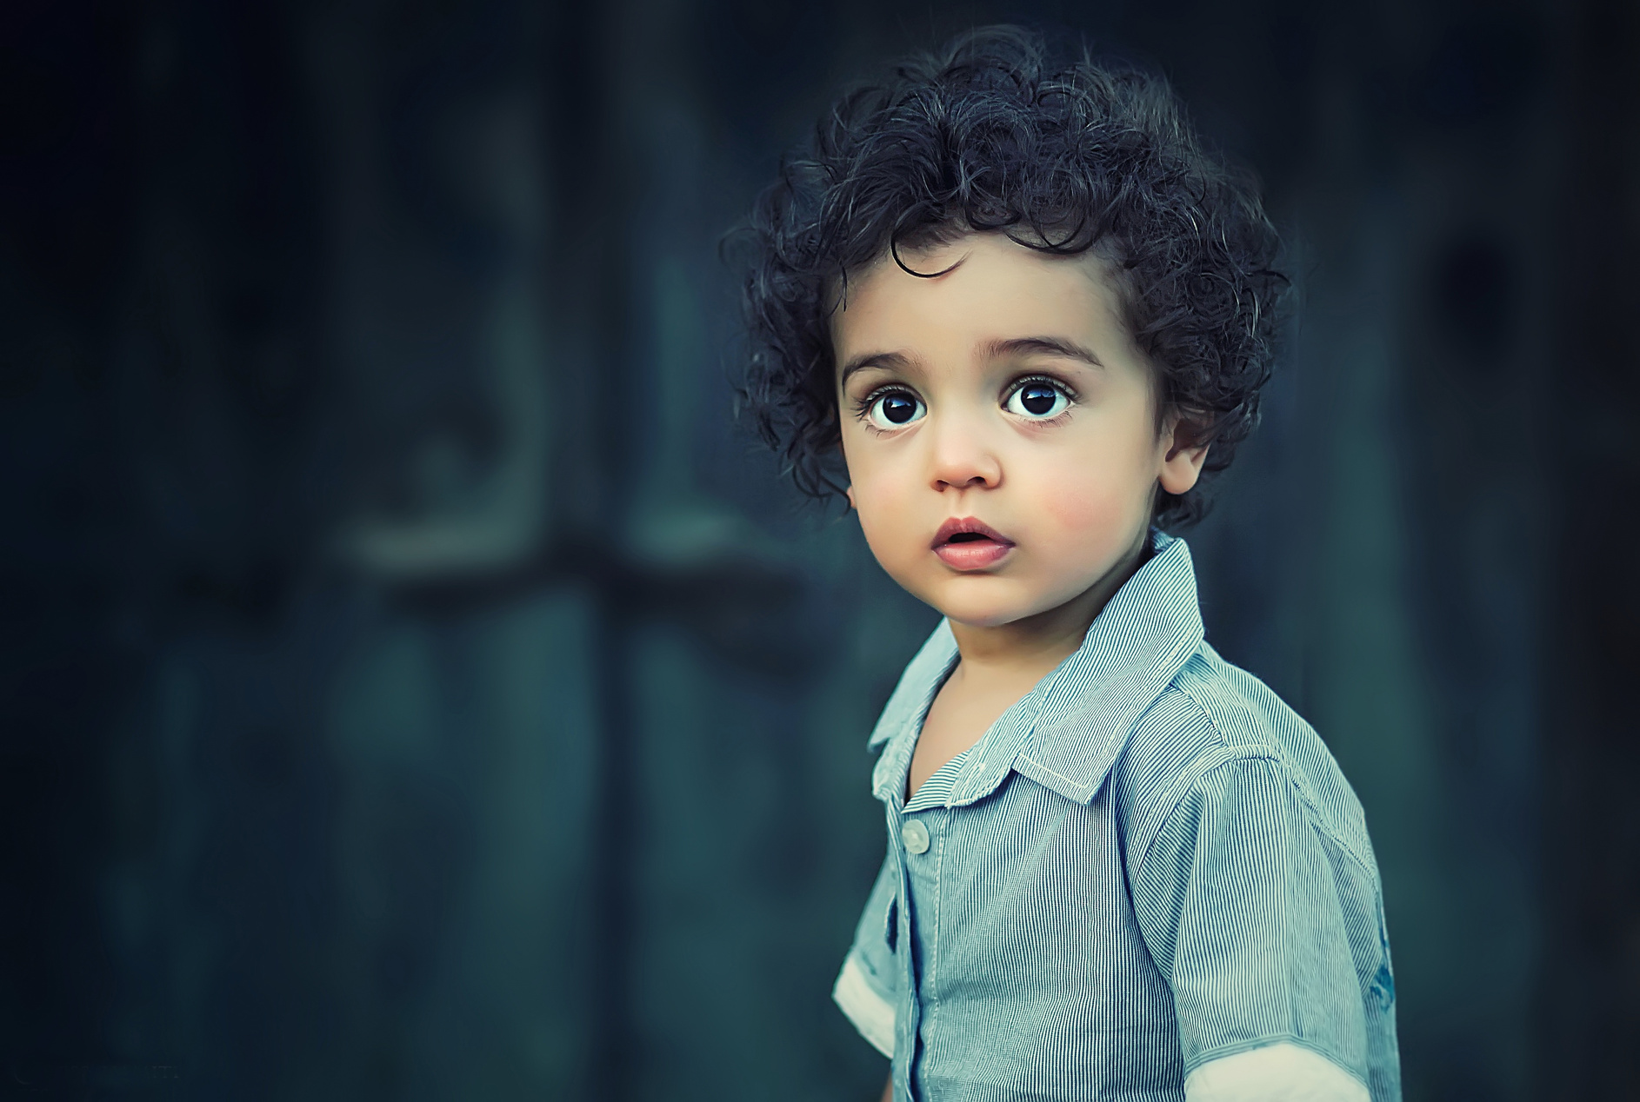

MISSING CHILD
PLEASE HELP
ALEXANDER
AGE: 6
HAIR: Black, curly
EYES: Black
WEIGHT: 45.5 lbs
HEIGHT: 3.5 feet
WEARING:
He was last seen wearing a blue shirt and a black jeans
Please call if you have any information
ANNA
123-456-7890

