Slide 1


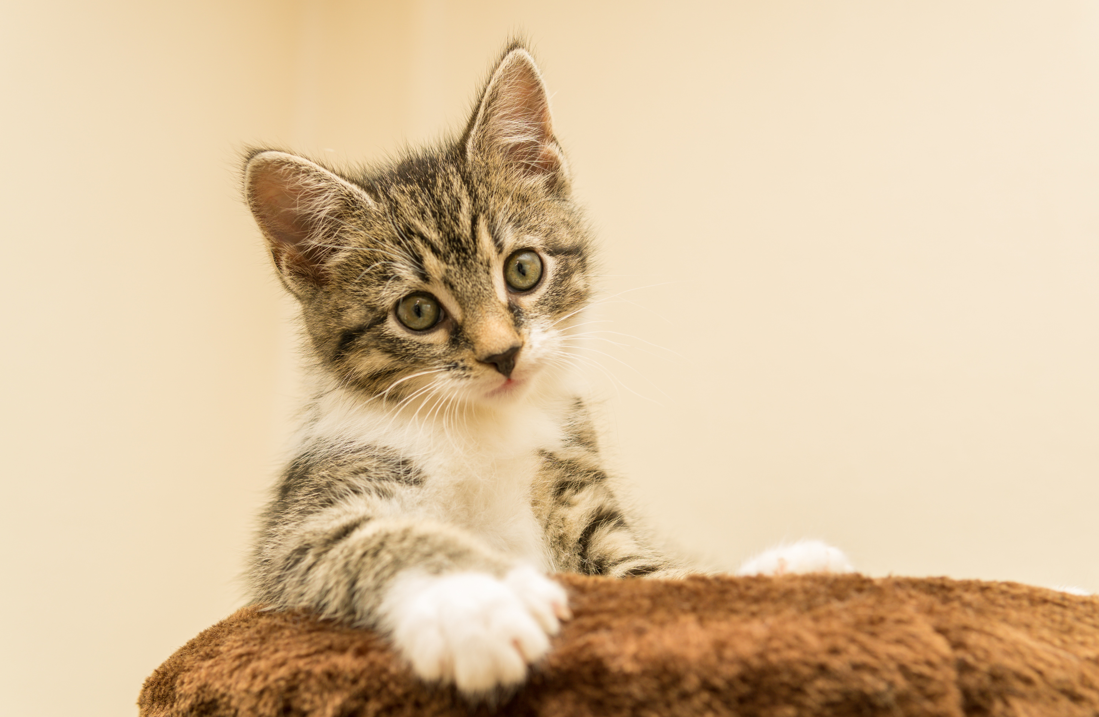




MISSING CAT
LAST SEEN AT WHISPERING WILLOW PARK
REWARD
$ 200
FACEBOOK
ADDRESS
PHONE
hellotemplateLAB
123 Anywhere St., Any City, ST 12345
+123-456-7890

