Slide 1
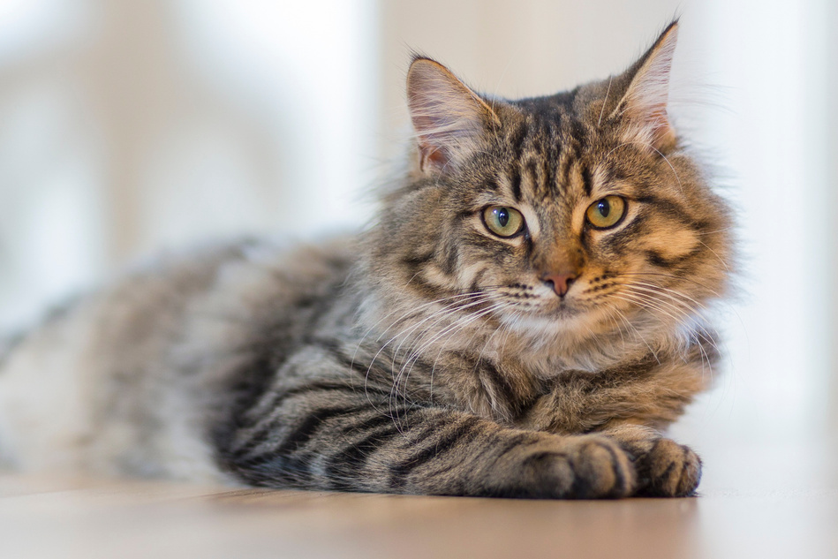
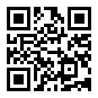

MISSING CAT
REWARD
$800
LOUIS - THE NORWEGIAN FOREST CATORTHAIR CAT
LAST SEEN AT
DREAM PARK - at the roller coaster area
WEARING
Necklace with white-brown herringbone pattern. On the necklace, there is a grey bell and a name, both engraved with Louis' name
DISTINCTIVE FEATURES
Truncated tail - bright yellow eyes - Has a heart shape on the back
- One left foot has white fur
SCAN
ME
PLEASE CALL OR TEXT WITH ANY INFORMATION
123-456-7890

