Slide 1



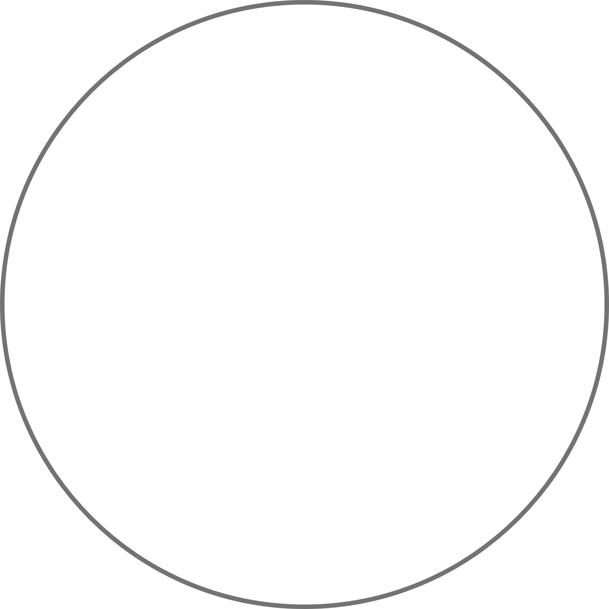











BUBBLE MAP GRAPHIC ORGANIZER
A bubble map graphic organizer is a visual tool used for brainstorming, organizing ideas,
and representing information in a hierarchical or relational manner.
Learn about the audience
Define your scope
Observe and Interview
Look for patterns and insights
Listen
Questions assumptions
Ask questions
01
02
Frame your P.O.V
EMPATHIZE
DEFINE
Iteration and Adaptation
Come up with many solutions
Monitoring and Evaluation
06
DESIGN
THINKING
03
Experiment
IMPLEMENT
IDEATE
Execution Plan
Co-create with team members
Cross-Functional Collaboration
Brainstorm and select
05
04
User testing and surveys
TEST
PROTOTYPE
Think big, act small, fail fast
Evaluate
Gather feedback
Gather learning
Refine
Iterate and scale
Learn from users

