Slide 1
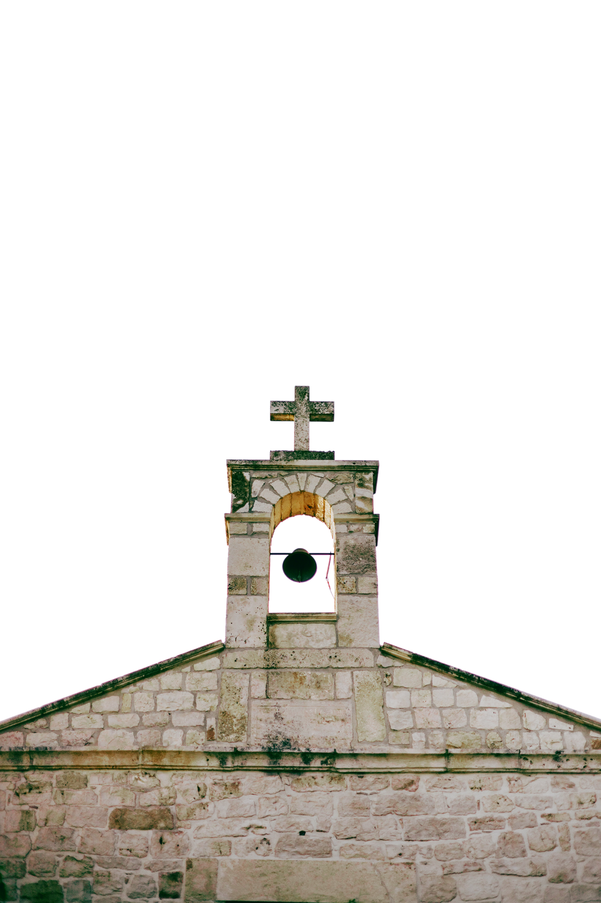
The LORD is my light and my salvation; whom shall I fear? The LORD is
the stronghold of my life;
of whom shall I be afraid?
FIRST PRESBYTERIAN CHURCH
- Psalm 27:1
Finding Peace in the Storm
Connect with Us
1234 Grace Lane, Presbyterian Town
+123-456-7890
www.templatelab.com

Slide 2
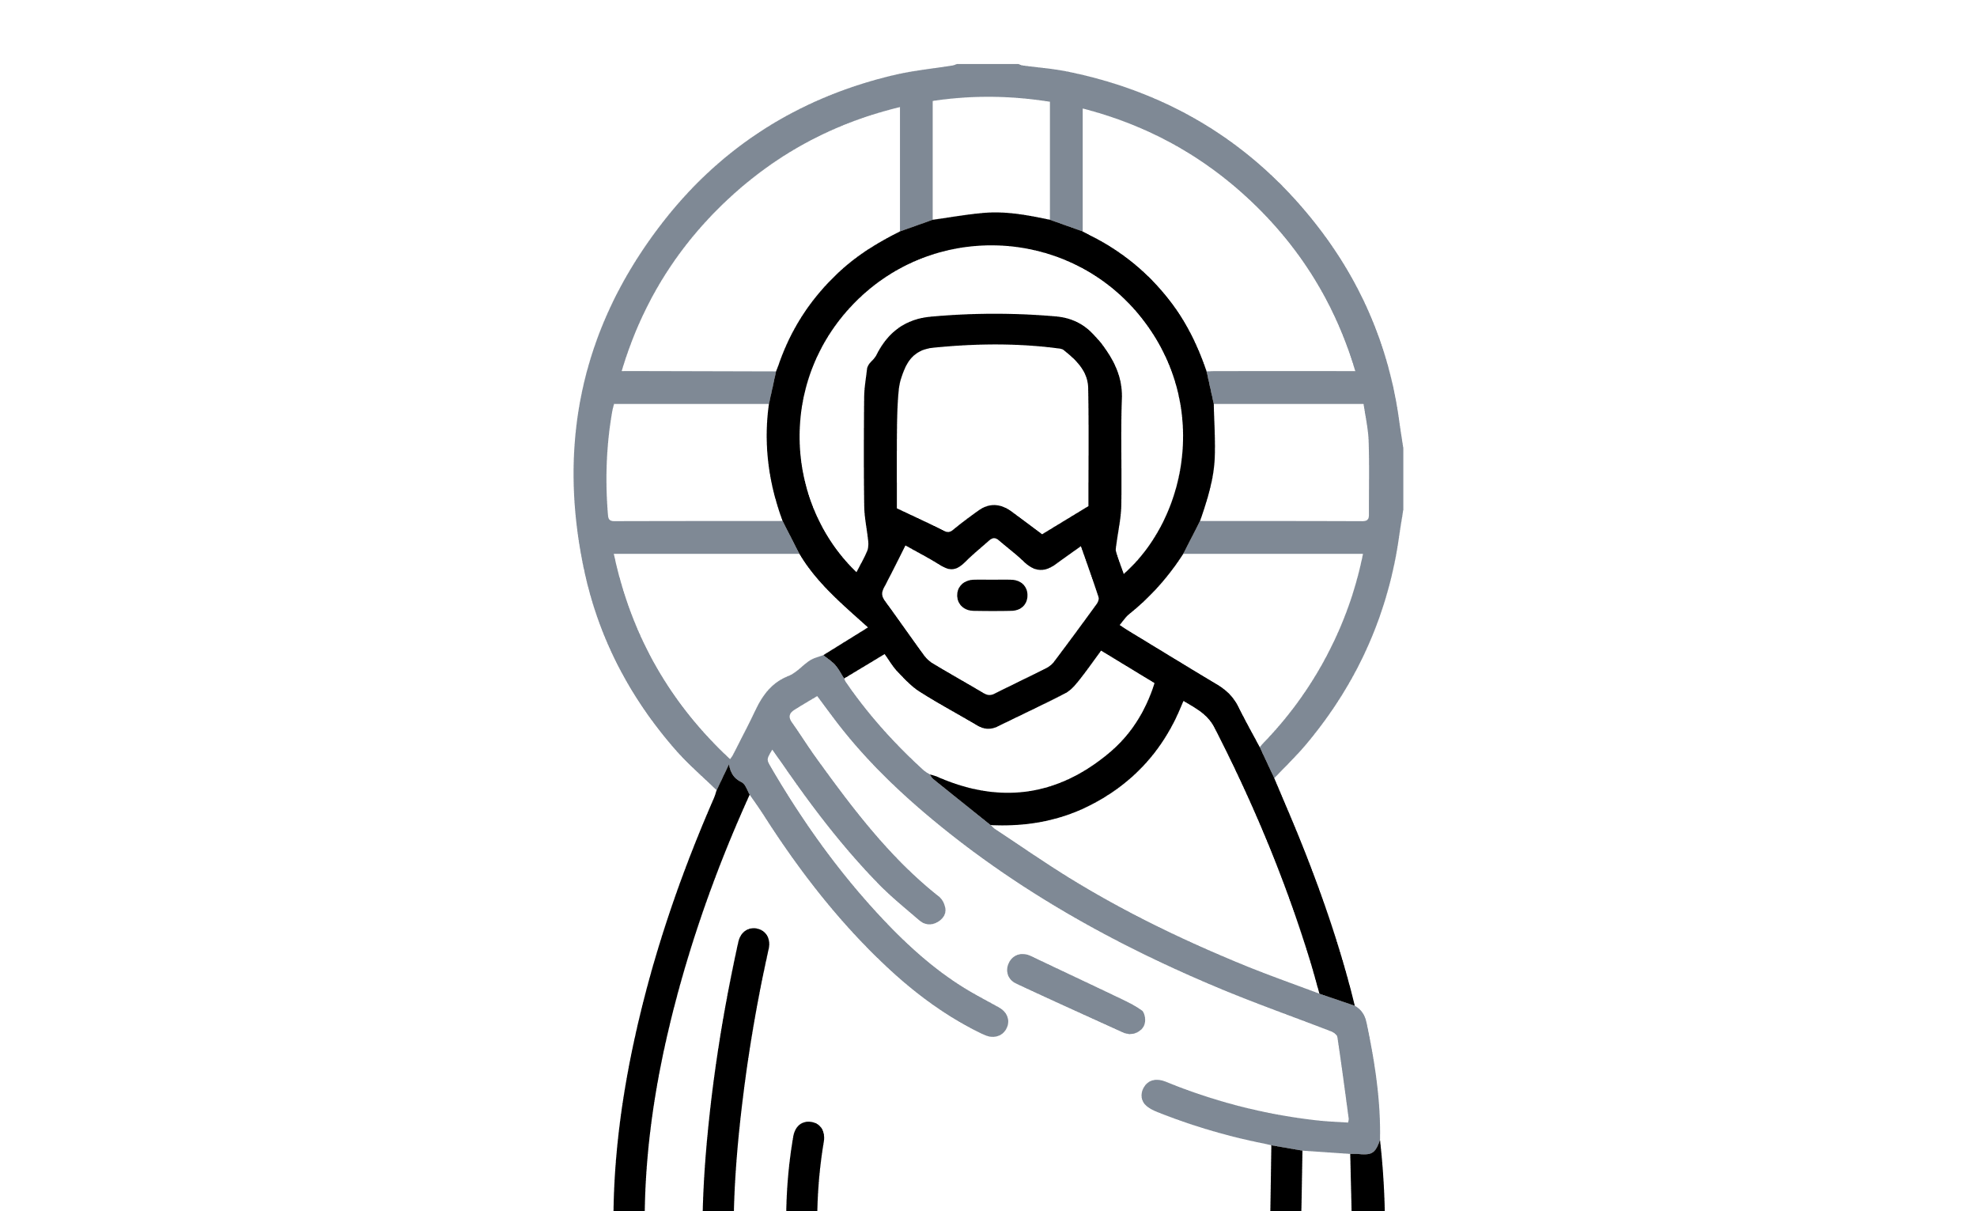
ORDER OF WORSHIP
This Week at
First Presbyterian
Prelude
Selection by our Organist
YOUTH GROUP
Welcome and Announcements
Wednesdays, 6:30 PM in the Youth Room.
Pastor John Doe
BIBLE STUDY
Thursdays, 7 PM in the Fellowship Hall.
Call to Worship
Led by Elder Jane Smith
Prayer of Confession
Led by the congregation
Assurance of Pardon
Pastor John Doe
Passing of the Peace
About First
Presbyterian Church
Share a sign of Christ's peace
with those near you
First Presbyterian Church is a community of believers united by our faith in Jesus Christ. We welcome all who seek to grow in grace, love one another as Christ loved us, and serve in our world as bearers of the Good News.

