Slide 1
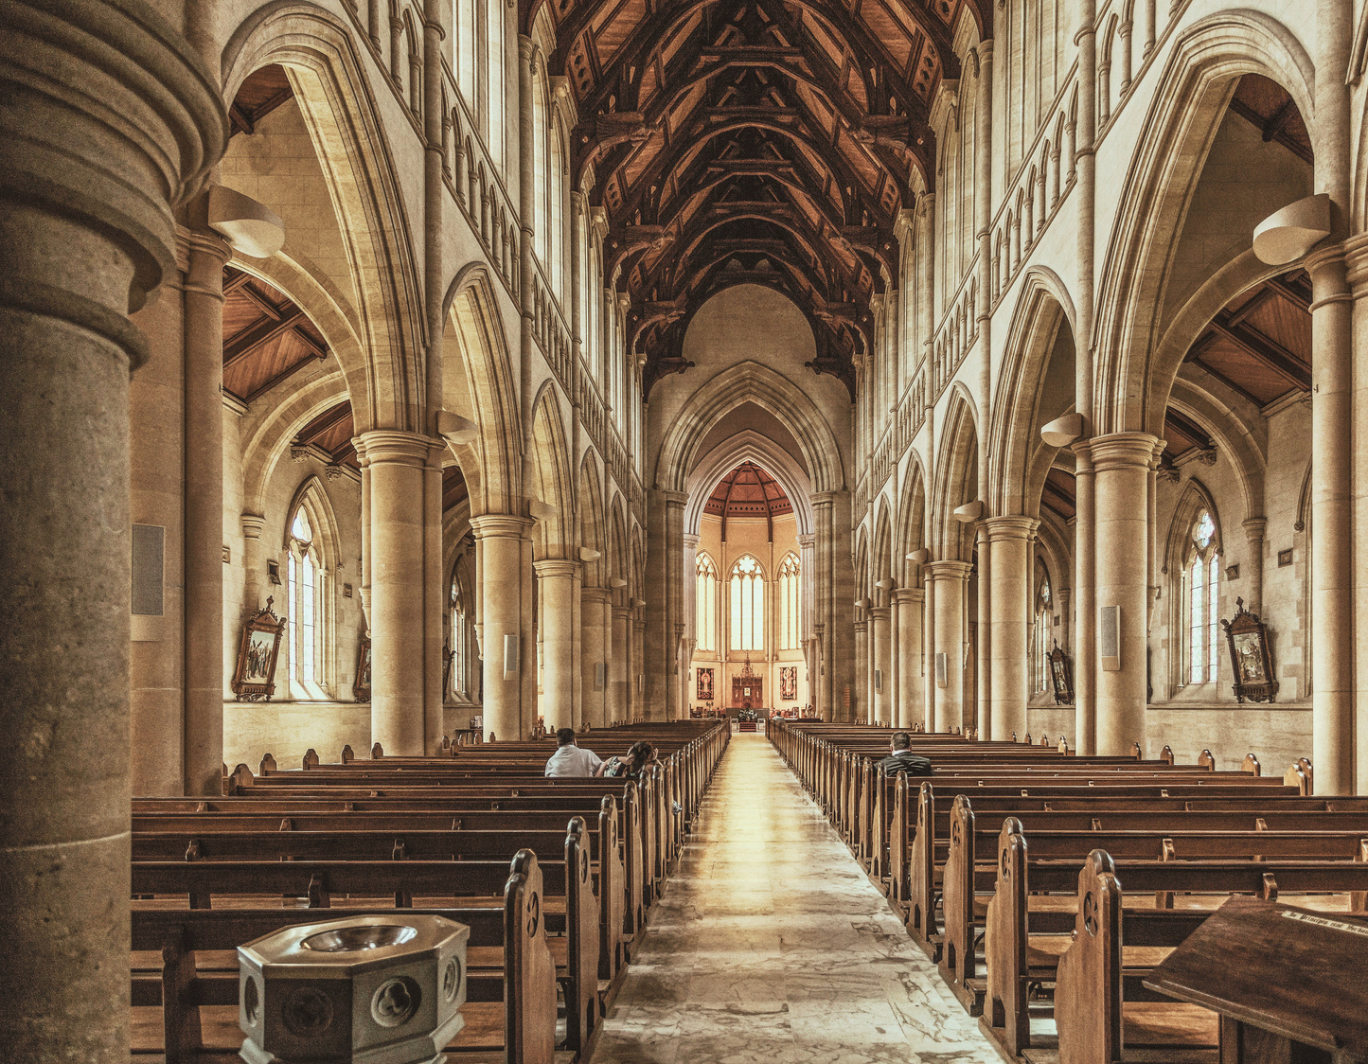
Darkness cannot drive out darkness; only light can do that. Hate cannot drive out hate; only love can do that.
- Martin Luther King Jr.
Revolution City Church
Contact Us
123-456-7890
123-456-7890
Revolution
City Church
hello@templatelab.com
templatelab.com
123 Anywhere St., Any City, ST 12345
Sunday workshop program

Slide 2
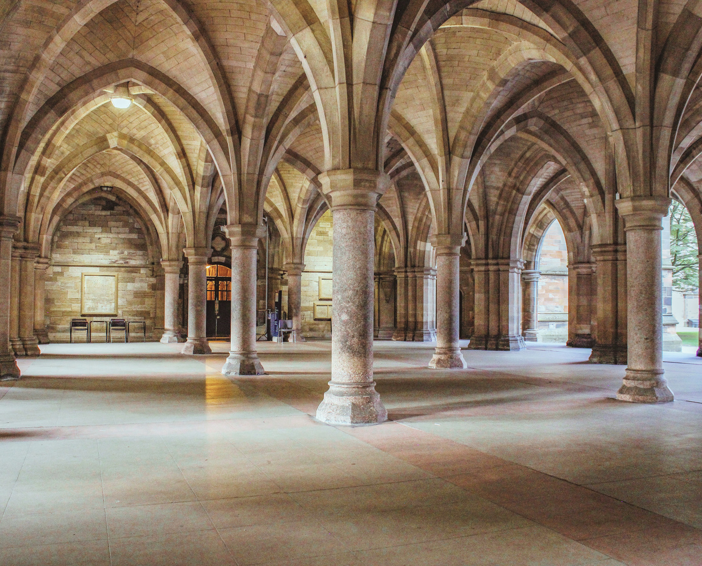
ORDER OF SERVICE
WELCOME & VISION STATEMENT
Opening Song
Welcome to Revolution City Church.
We are a vibrant, inclusive community committed to living out Jesus' revolutionary message of love. Our vision is to create
a space where love is the default, where acceptance is unconditional, and where everyone feels at home.
"This is Amazing Grace"
Community Prayer
Led by Pastor Jane Doe
Scripture Reading
1 John 4:7-12, by Elder Tom Smith
NEWCOMERS
New to Revolution City Church?
We're glad you're here! Join us for our newcomers' meetup every Sunday after the service. You'll get a chance to meet our pastor and learn more about our community. Let's connect and make you feel at home.
Message
"Radiate Love Living Out Divine Love
in Everyday Life", by Pastor Jane Doe
ONLINE
SERVICES
Can't make it in person? No worries. Join our live-streamed services every Sunday
on our website or catch up later on our YouTube channel. Wherever you are,
we're there for you.
Closing Song
"Build Your Kingdom Here"

