Slide 1
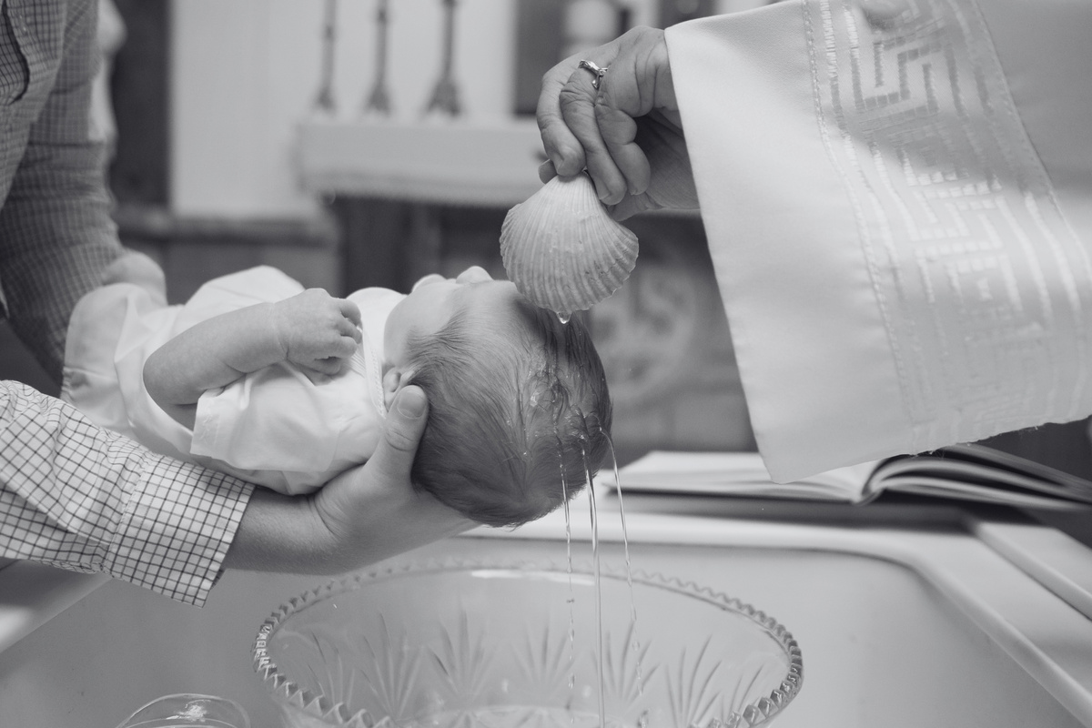
About First Baptist Church of Hometown
Established in 1923, First Baptist Church of Hometown has faithfully served our community, spreading the Gospel's good news and extending a hand of fellowship and service to all.
"WELCOMING ALL TO THE HOUSE OF OUR LORD"
Our Vision
To be a beacon of hope in our community, drawing people closer to God through our words, actions,
and service.
First Baptist Church
of Hometown
Our Mission
To disciple believers, evangelize the lost, and show Christ's love through acts of service and compassion.
Stay Connected
Address: 456 Baptist St, Hometown, USA
Phone: (123) 789-0123
Email: info@firstbaptisthometown.org
Website: www.firstbaptisthometown.org
August 13, 2023

Slide 2
Order of Service
"Trust in the Lord with all your heart and lean not on your own understanding; in all your ways submit to him, and he will make your paths straight."
Opening Hymn
- Proverbs 3:5-6
"O Worship the King" - Hymnal #21
Welcome & Greeting
Pastor John Doe
Upcoming Events
Prayer of Invocation
Deacon Mary White
Prayer Meeting
Scripture Reading
Join us every Wednesday at 6 PM for our community
prayer meeting.
John 3:16-21, read by Brother James Black
Hymn of Praise
Sunday School
"Blessed Assurance" - Hymnal #45
Registration is open for Sunday School! Ages 4-12,
starts next month.
Sermon
"Embracing God's Love" by Pastor John Doe
Baptism Class
Hymn of Response
Our next Baptism Class is on August 20th, 6 PM.
Contact Deacon Paul to sign up.
"Come Thou Fount" - Hymnal #98
Church Picnic
Benediction
Pastor John Doe
Don't forget our annual Church Picnic on August 27th
at Hometown Park. All are welcome!

