Slide 1

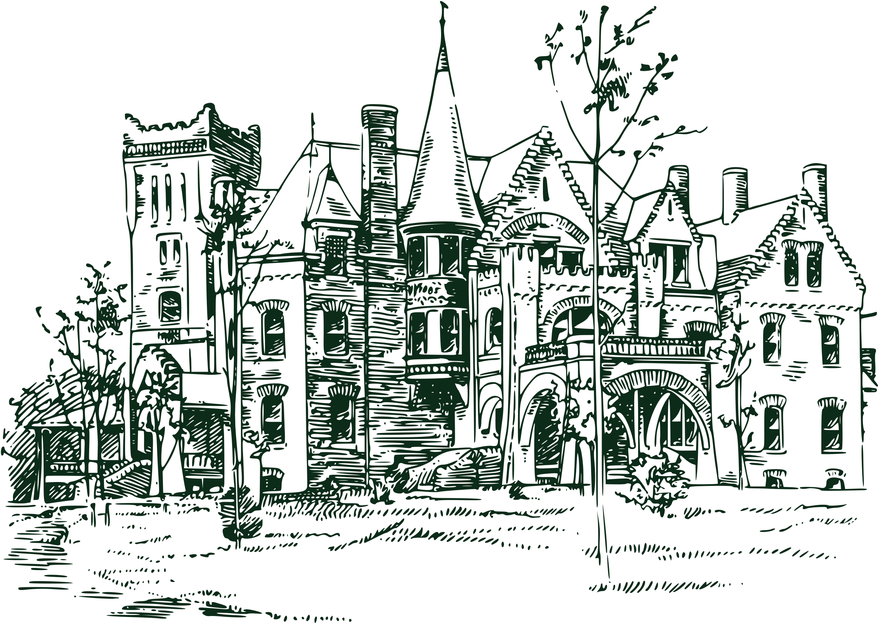


Haunted Mansion
Death Certificate
TO:
In memory of your dead-fast devotion to the famed Haunted Mansion DoomBuggies.com hereby admits you to your final resting place amongst
our Grim Grinning Family of Silly Spooks and Happy Haunts. Il Signed,
Date of Passing
Undertaker

