Slide 1
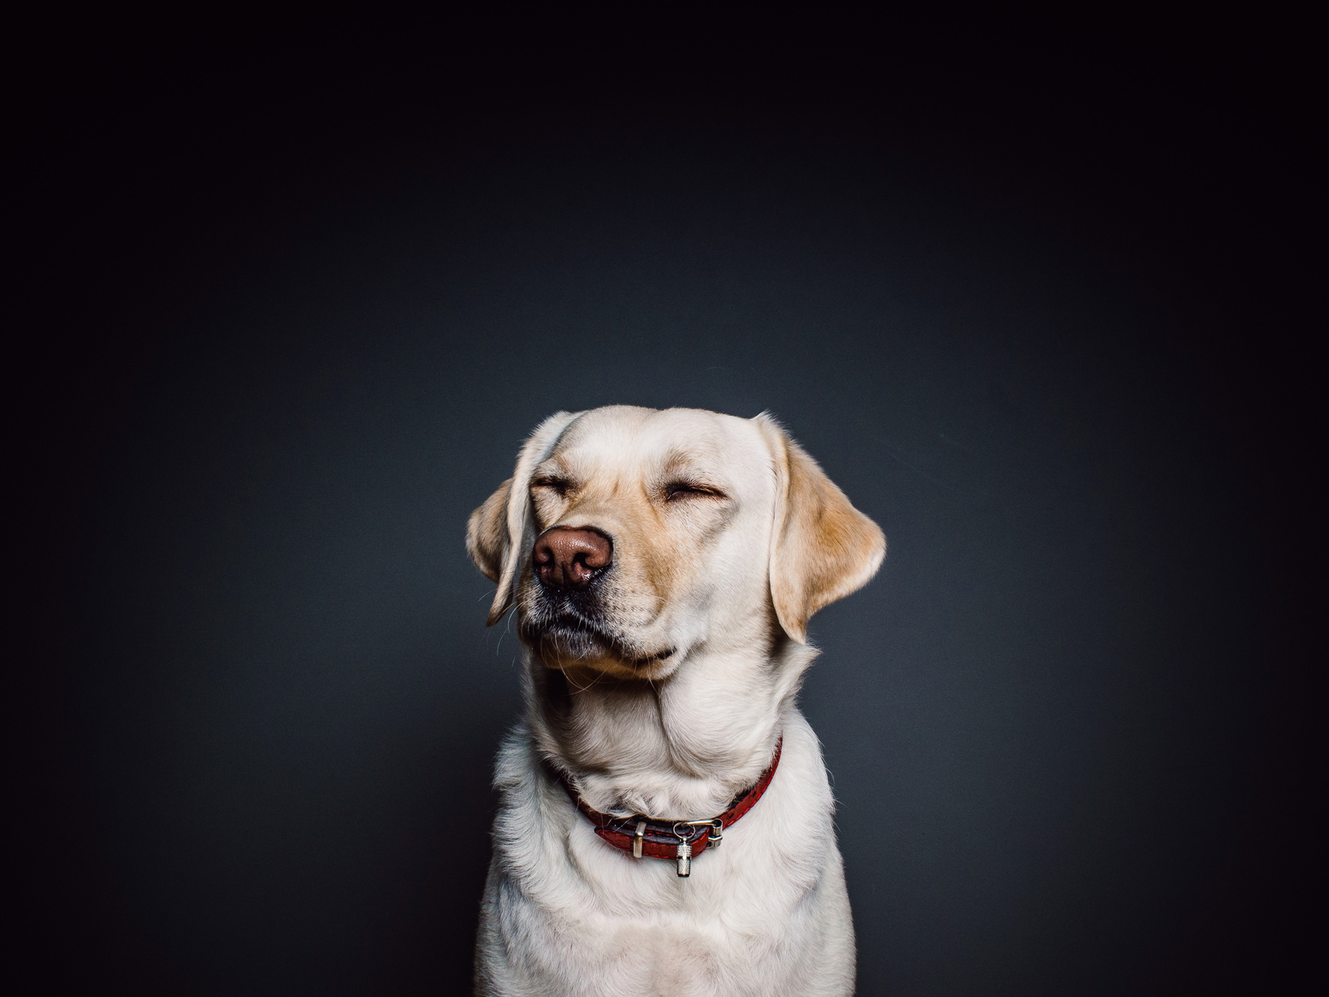

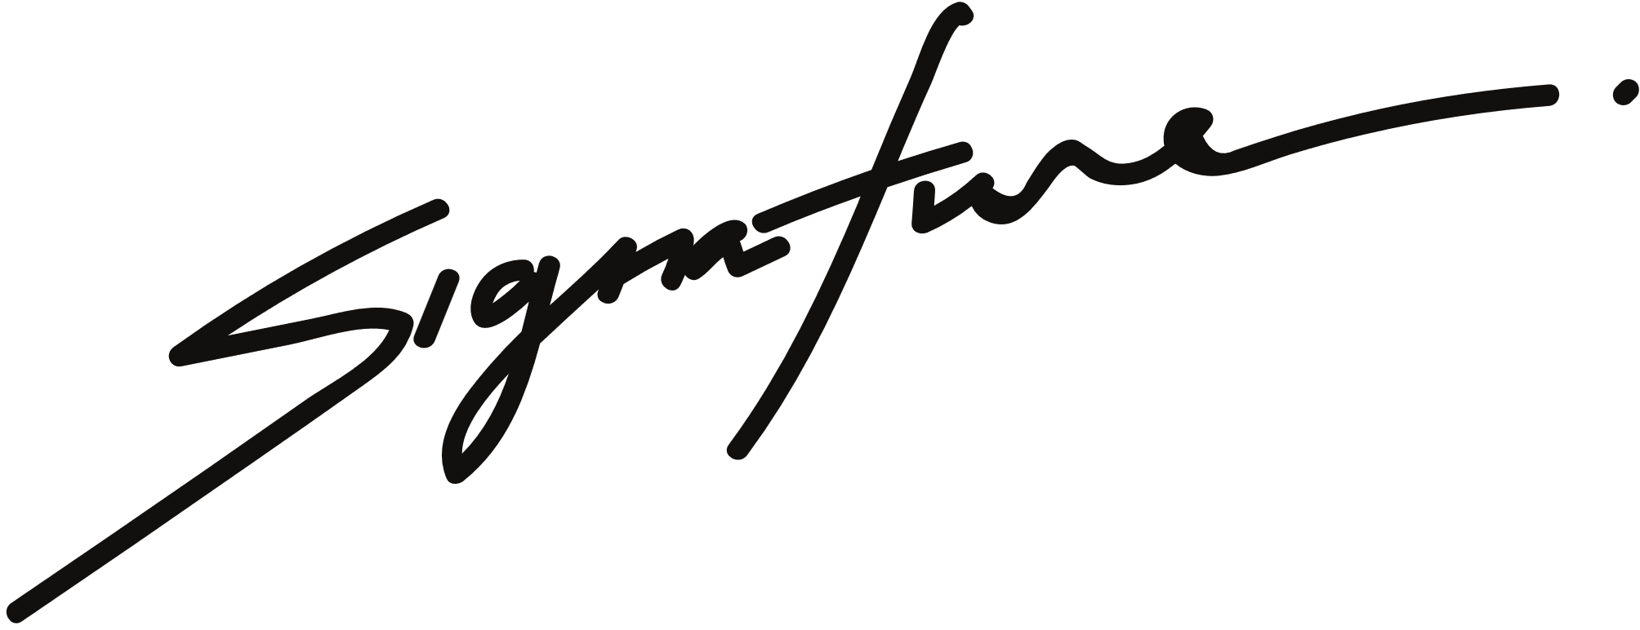

Dog death certificate
This certifies that
Dog’s Name
Born:
Died:
To our cherished dog, you were simply the best. Thank you for the happiness, loyalty, and love you brought into our lives. Your presence was a beacon of comfort and joy, and we are eternally grateful. You will be missed but never forgotten.
OWNER'S SIGNATURE

