Slide 1

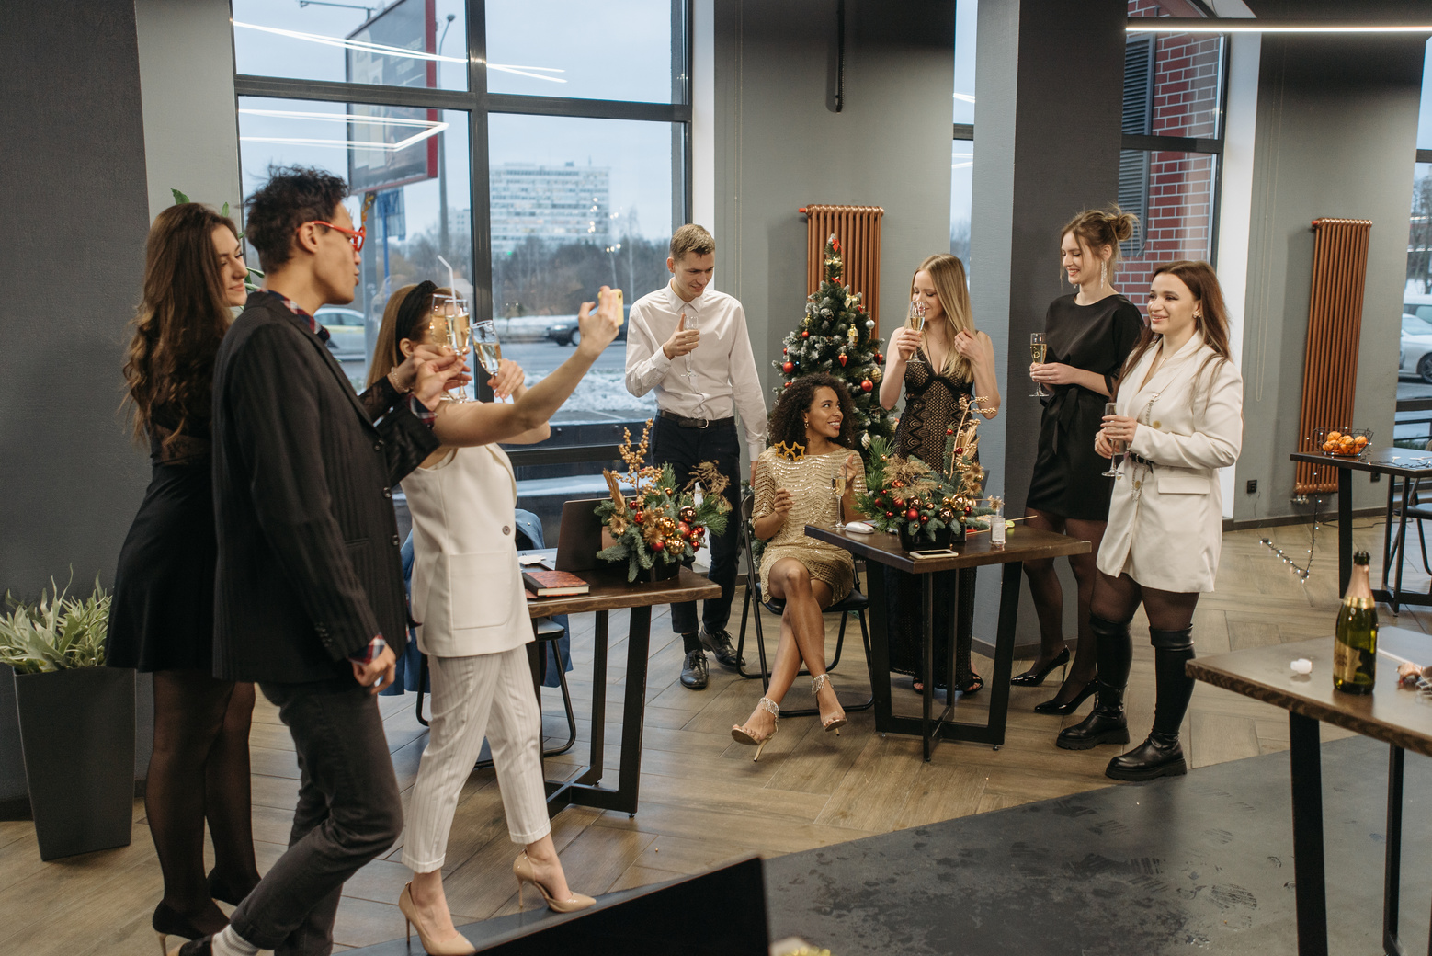

STAFF
CHRISTMAS PARTY
18:00 - 23:00
December 18th
123 Anywhere St., Any City, ST 12345
| DINNER AND DRINKS | DANCING |
| GIFT EXCHANGE | AWARDS |
www.company.com

