Slide 1
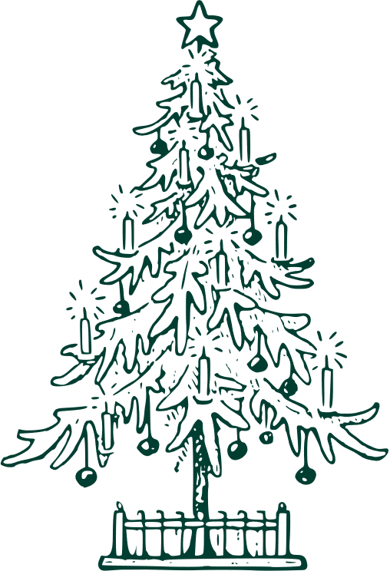



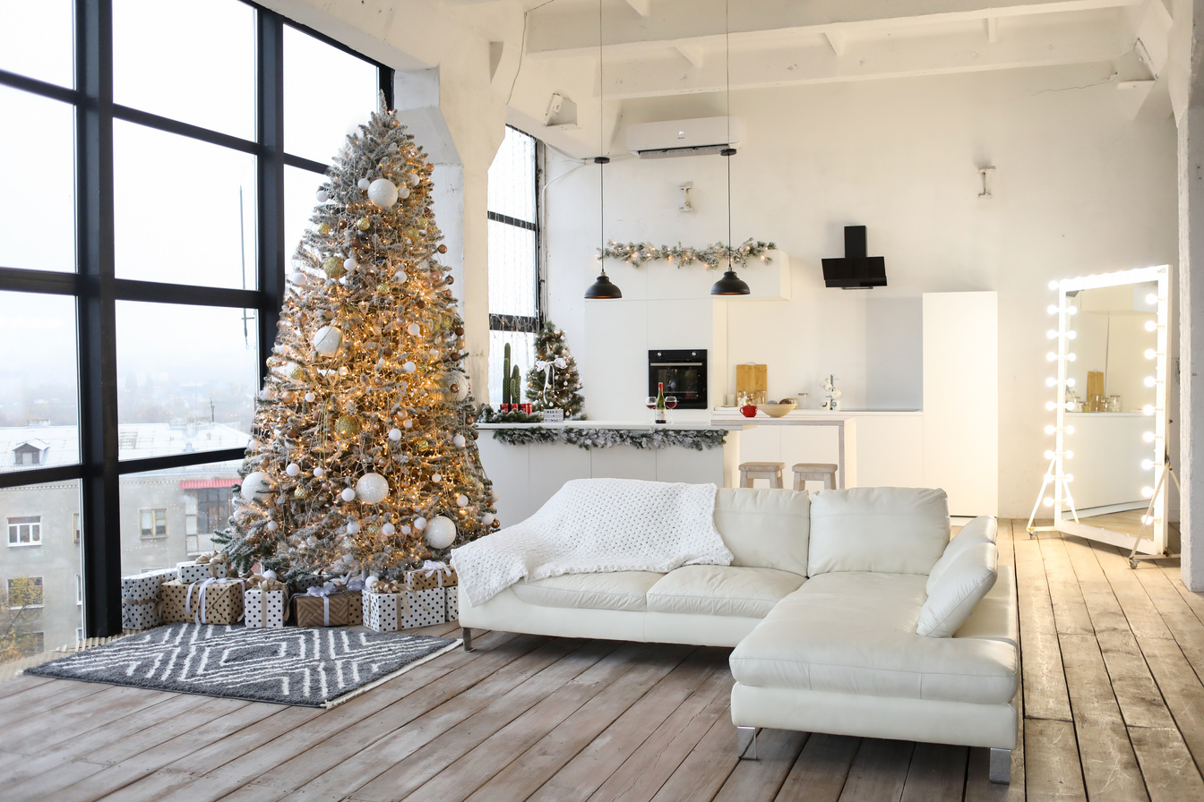

CHRISTMAS TREE SALES
Find your perfect Christmas tree at Greenwood's!
20%
Visit us at 1234 Pine St., North Pole, A
Discount
Or shop online at www.christmastrees.com
For more information, contact us at
(123) 456-7890

