Slide 1
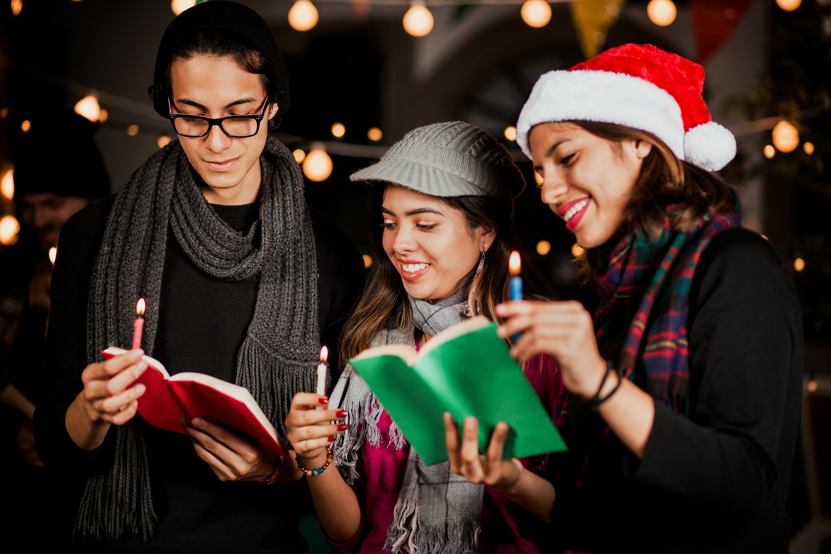

CHRISTMAS SERVICE
SCRIPTURE READINGS
TRADITIONAL CAROL SINGING
INSPIRING SERMON
All are welcome as we rejoice in the birth of our Savior. Let's share the Christmas spirit together!
10 AM | DECEMBER 25TH | 123 ANYWHERE ST., ANY CITY

