Slide 1


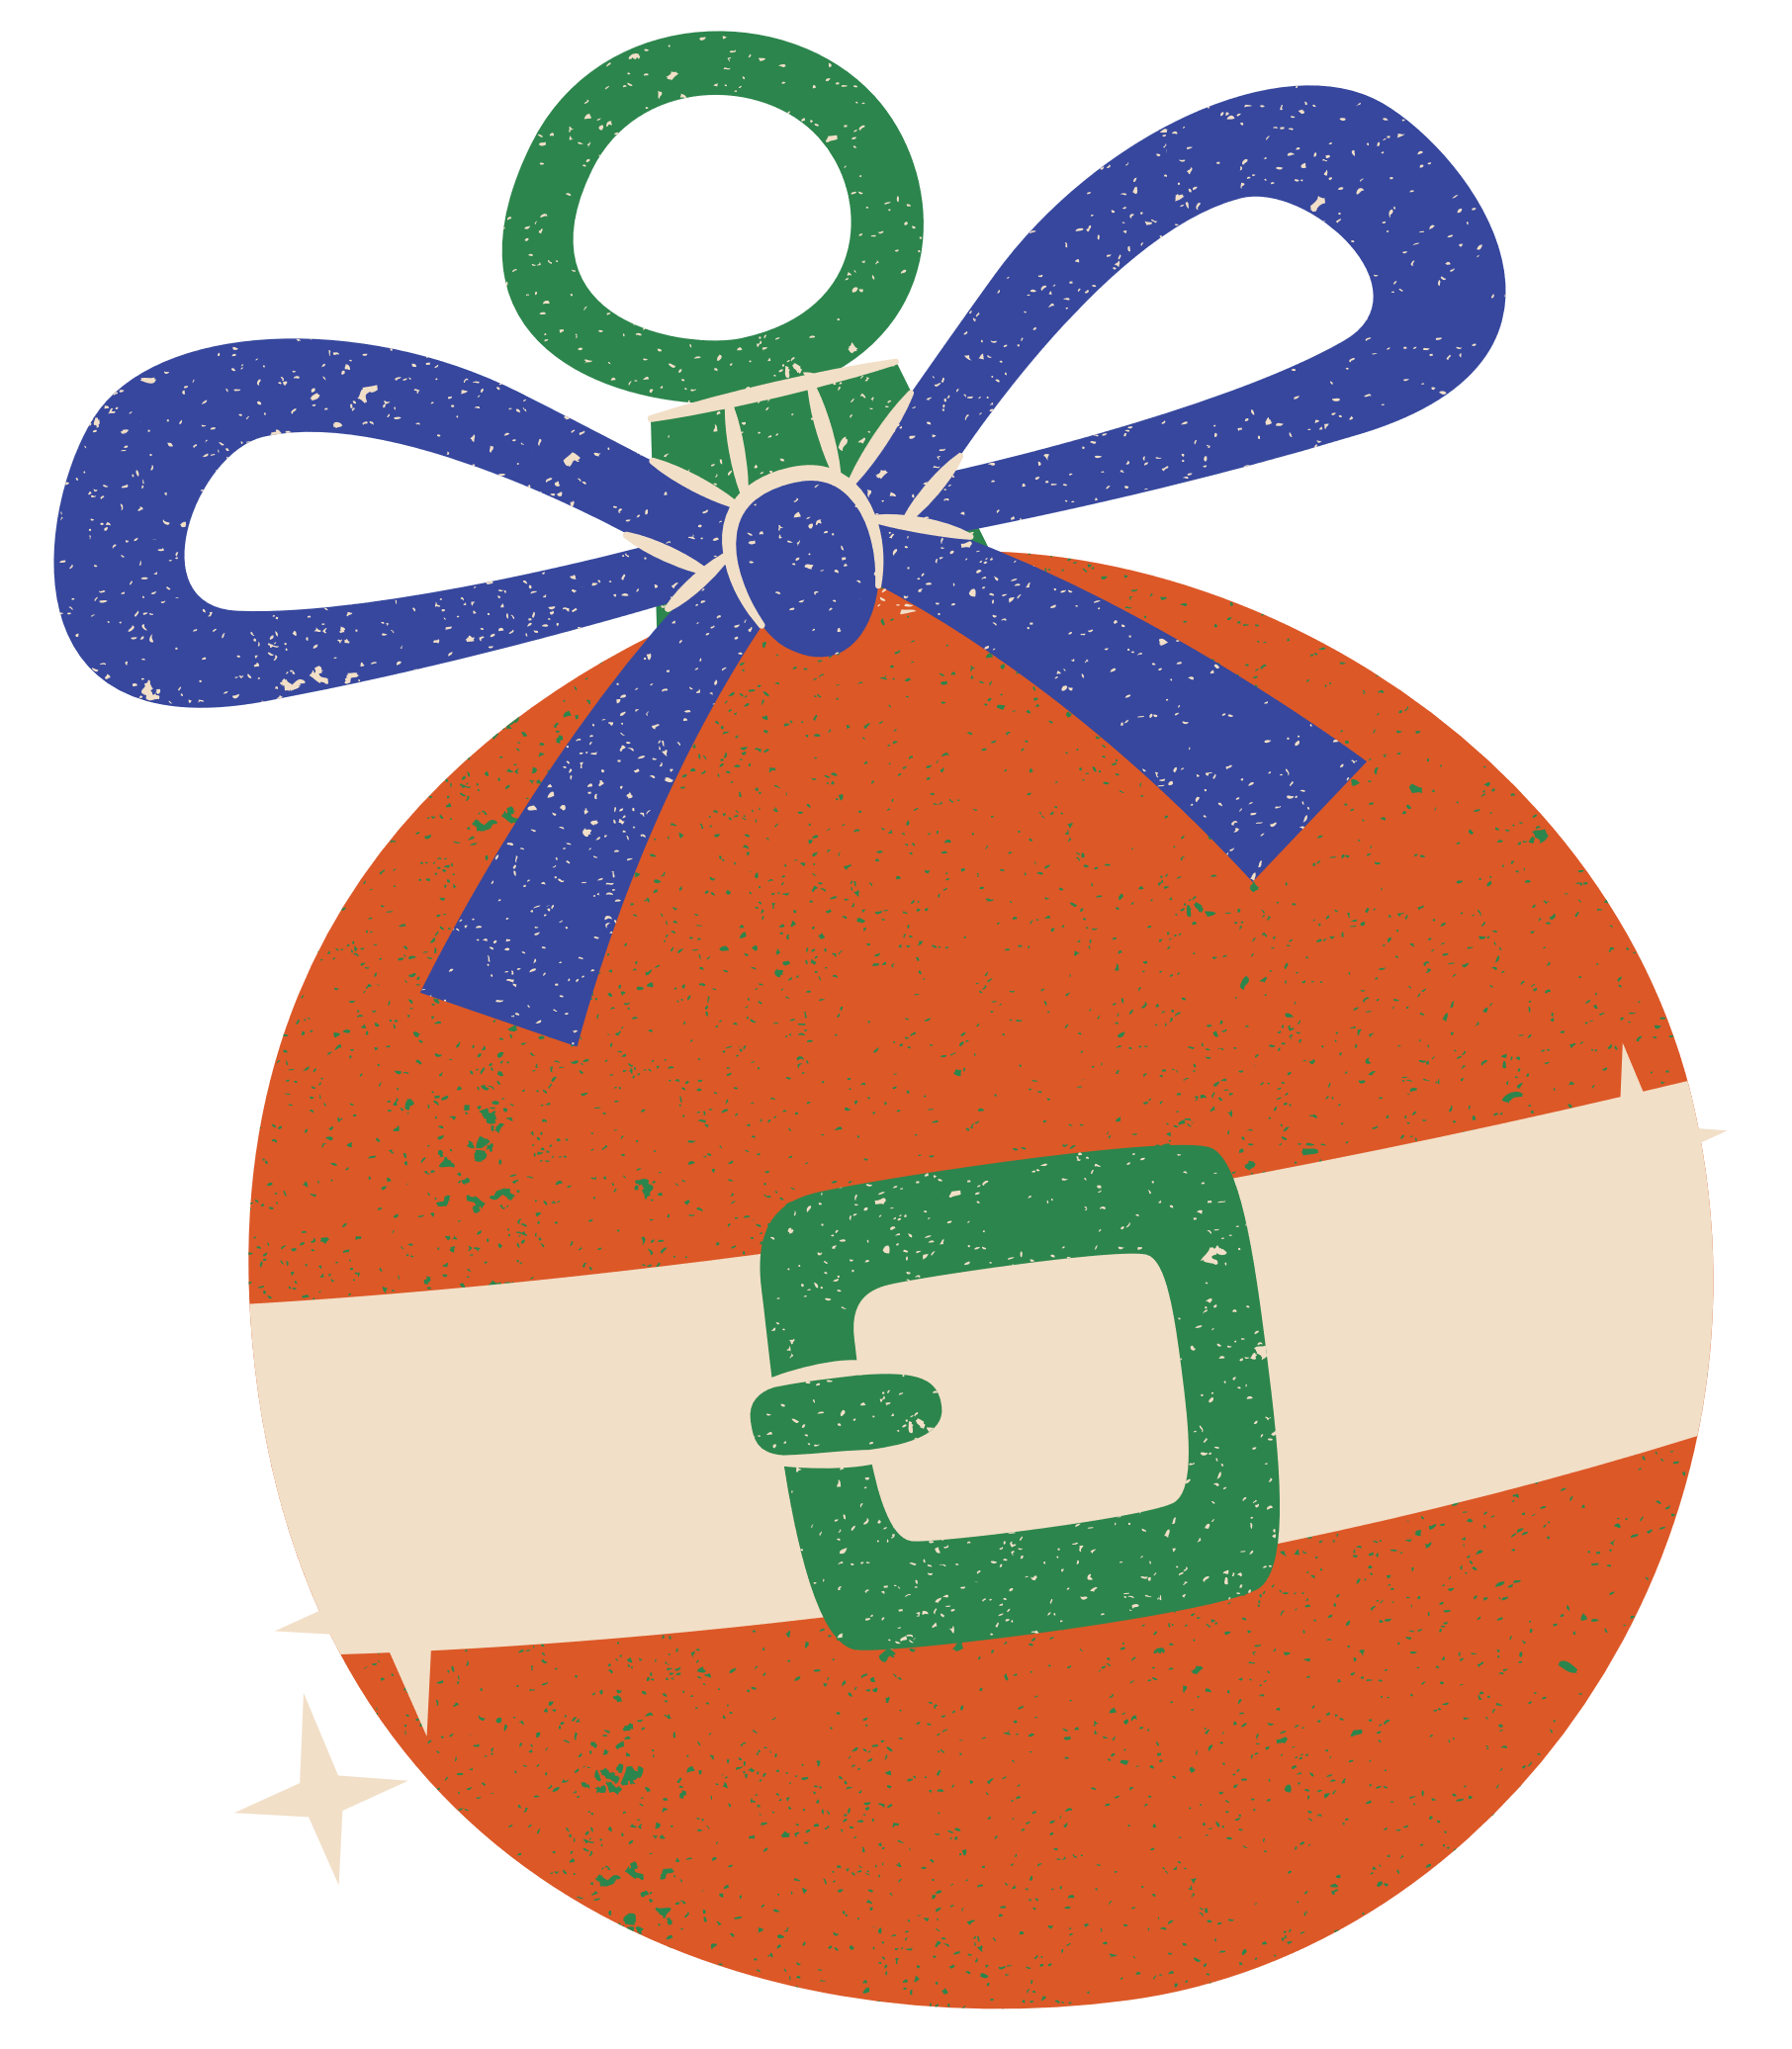

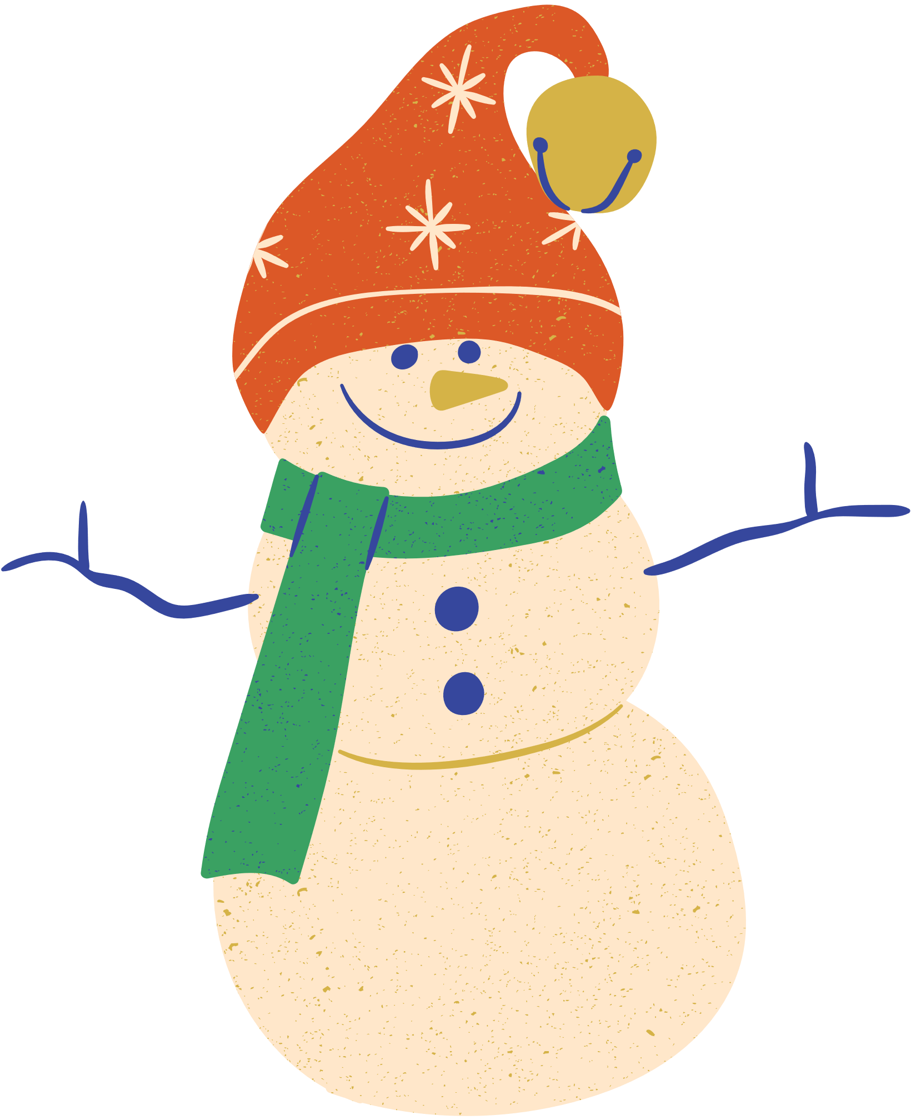
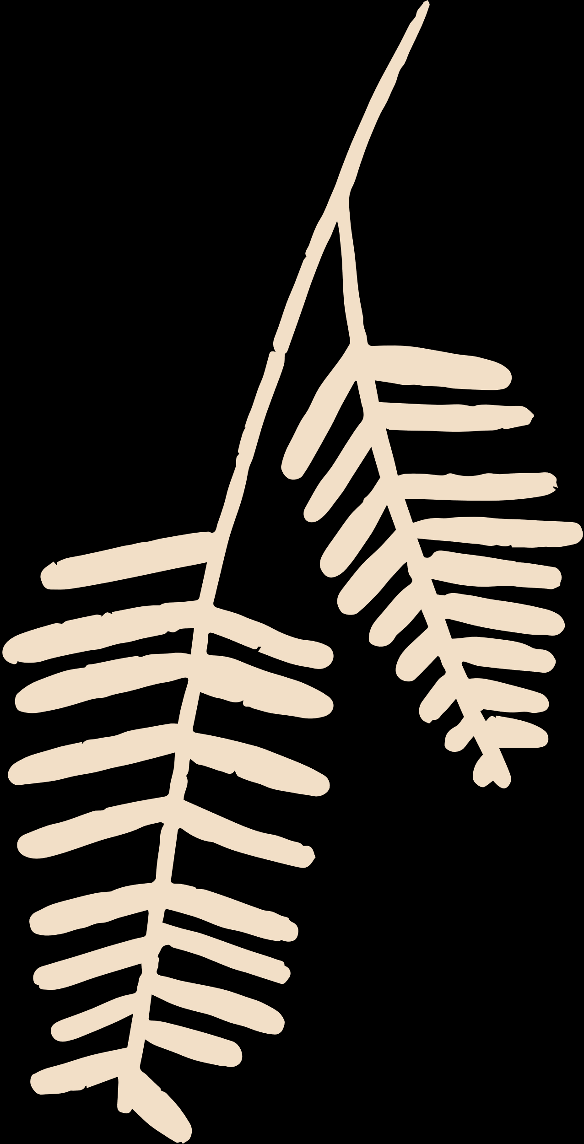
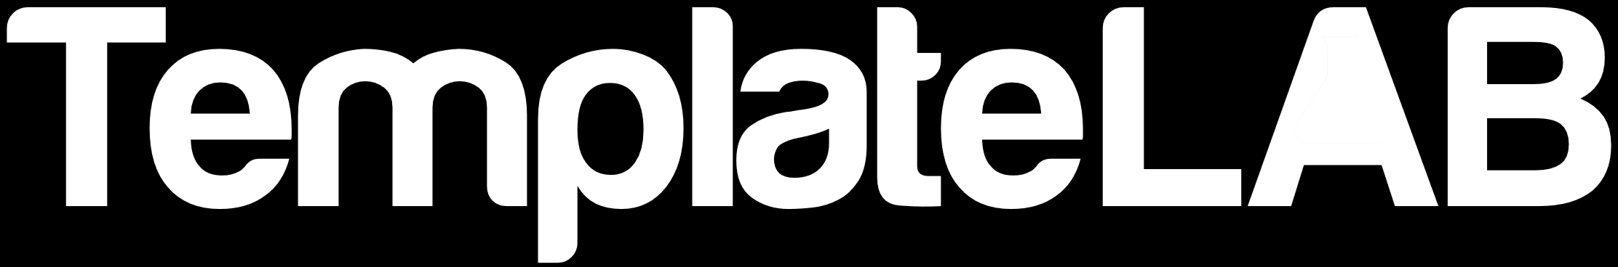
you're invited to
CHRISTMAS
PARTY
December 25th,
7:00 PM onwards
The Festive Hall, 7890 Holiday Avenue, Candy Cane City
Dress Code: Festive attire

