Slide 1




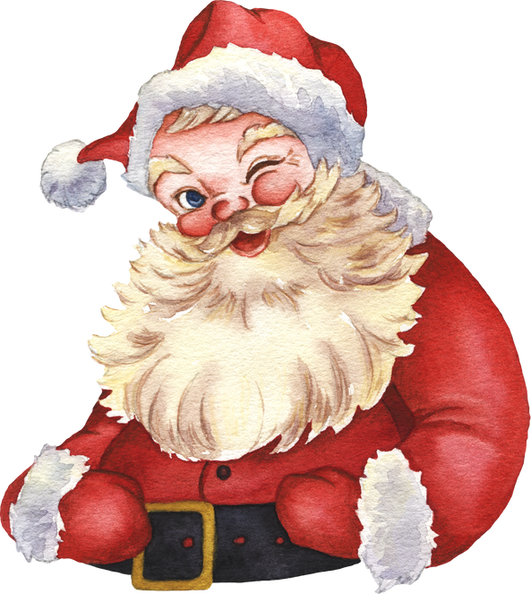
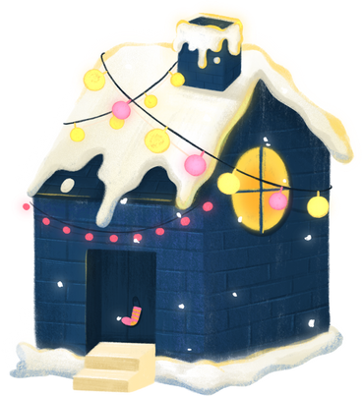




CHRISTMAS LUNCH
Celebrate the joy of Christmas
with our special festive lunch!
STARTER
Mushroom Soup
Prawn Cocktail
Goat Cheese Tart
MAIN COURSE
Roast Turkey with Veggies Seared Salmon with Rice Vegan Nut Roast with Veggies
DESSERTS
Christmas Pudding
Apple Crumble
Chocolate Yule Log
For reservations or more information, please contact us at
123-456-7890
December 25th | 12:00 PM - 3:00 PM | 123 Anywhere St., Any City, ST 12345

