Slide 1
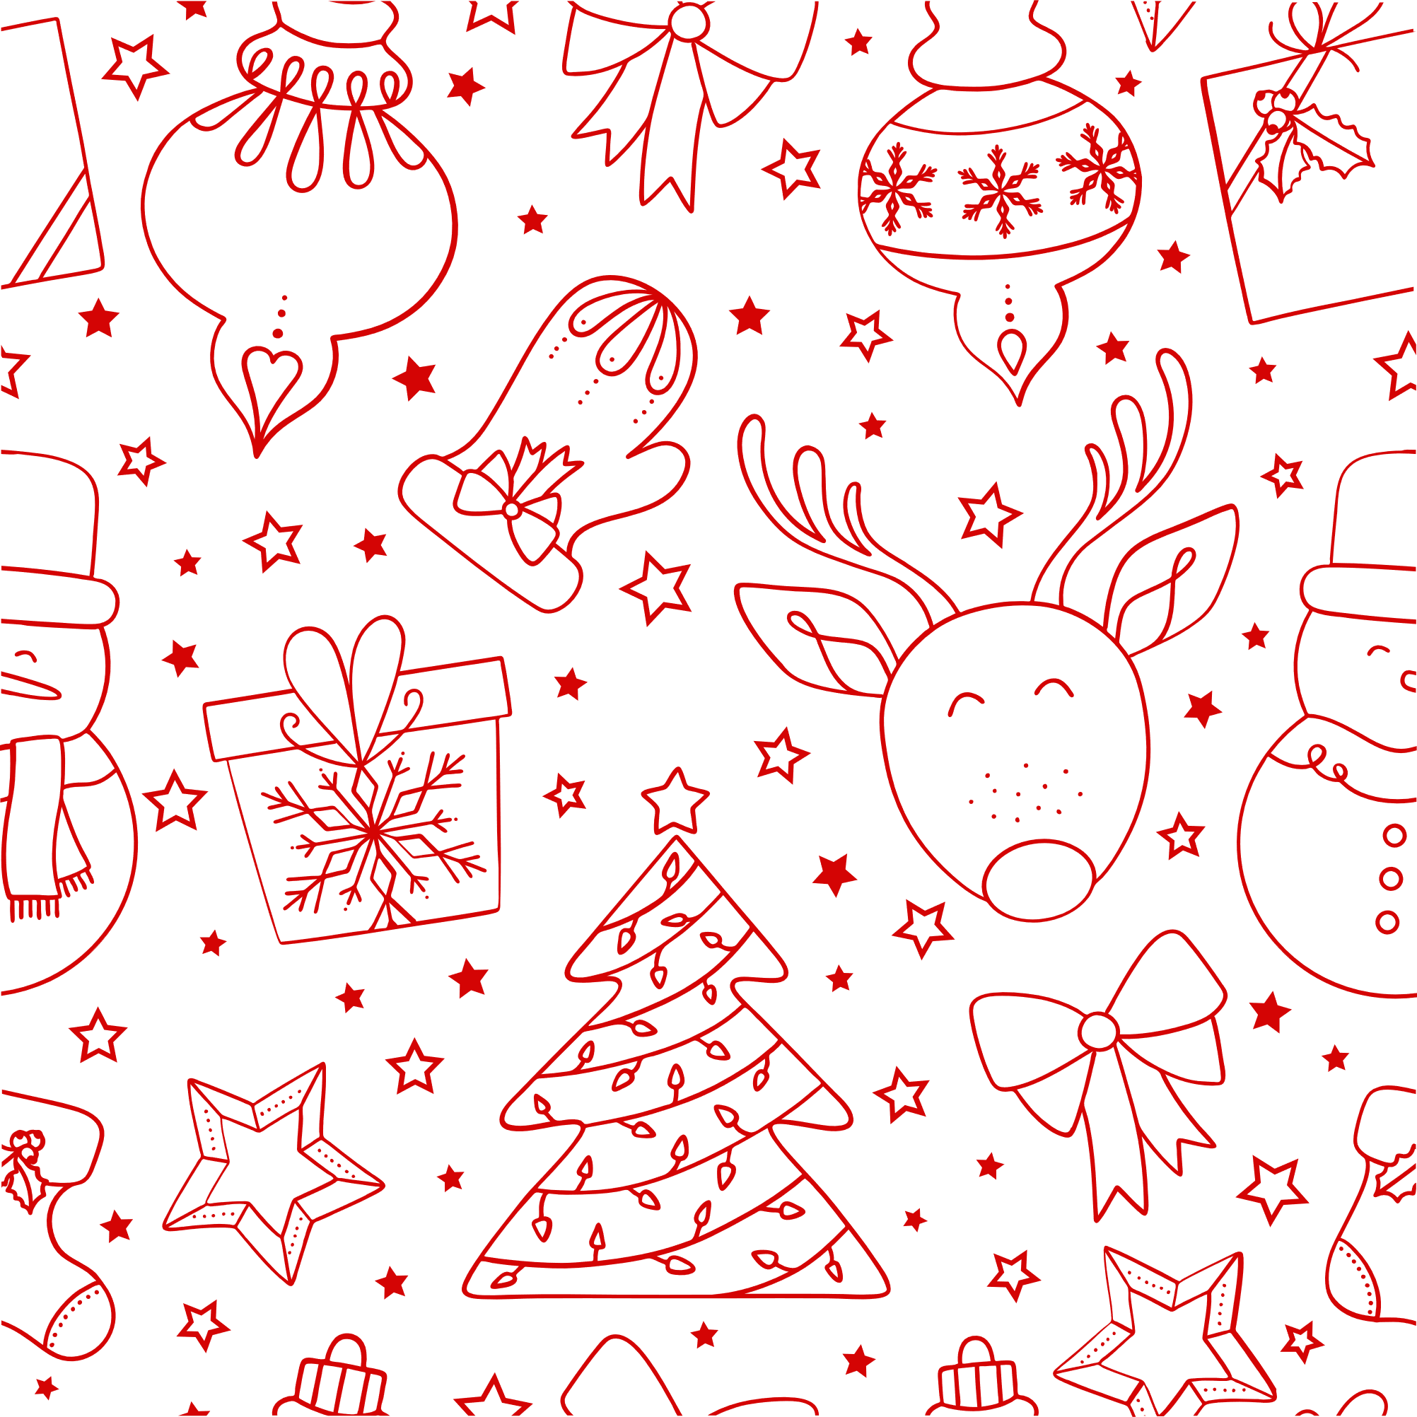




Christmas
Market
Get into the holiday spirit at our annual Christmas Market! Browse a variety of stalls filled with festive goods, perfect for your holiday shopping.
Handmade Crafts
Festive Foods
Unique, locally-made crafts, perfect for gifting
From hot cocoa to mince pies, enjoy holiday treats to keep your spirits high
Live Entertainment
Kids' Activities
Daily performances by local musicians to entertain while you shop
Fun games and a visit from Santa Claus to keep the little ones entertained
Sun, 12 December
8 AM - 5 PM
123 Anywhere St., Any City, ST 12345

