Slide 1
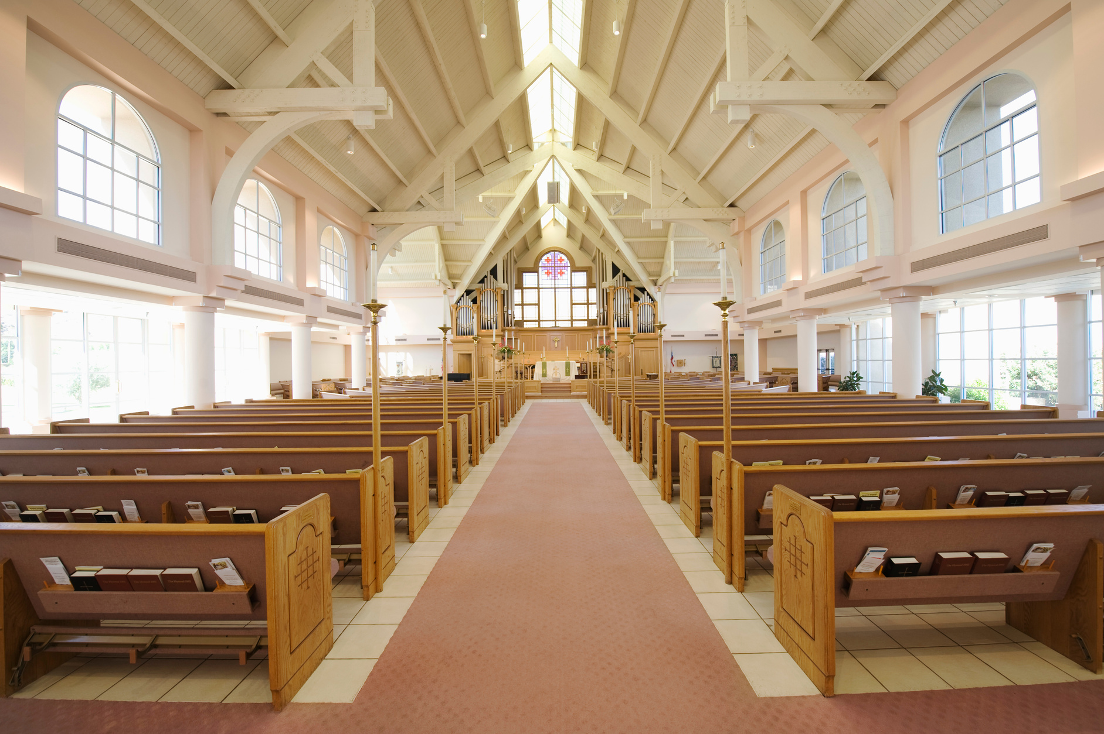

CHRISTMAS
A KING IS BORN
GRACE COMMUNITY CHURCH
December 24th, 2025
Service starts at 7PM
123 Anywhere St., Any City, ST 12345

