Slide 1
GIFT
CERTIFICATE
MERRY CHRISTMAS!
Value
$50

Slide 2
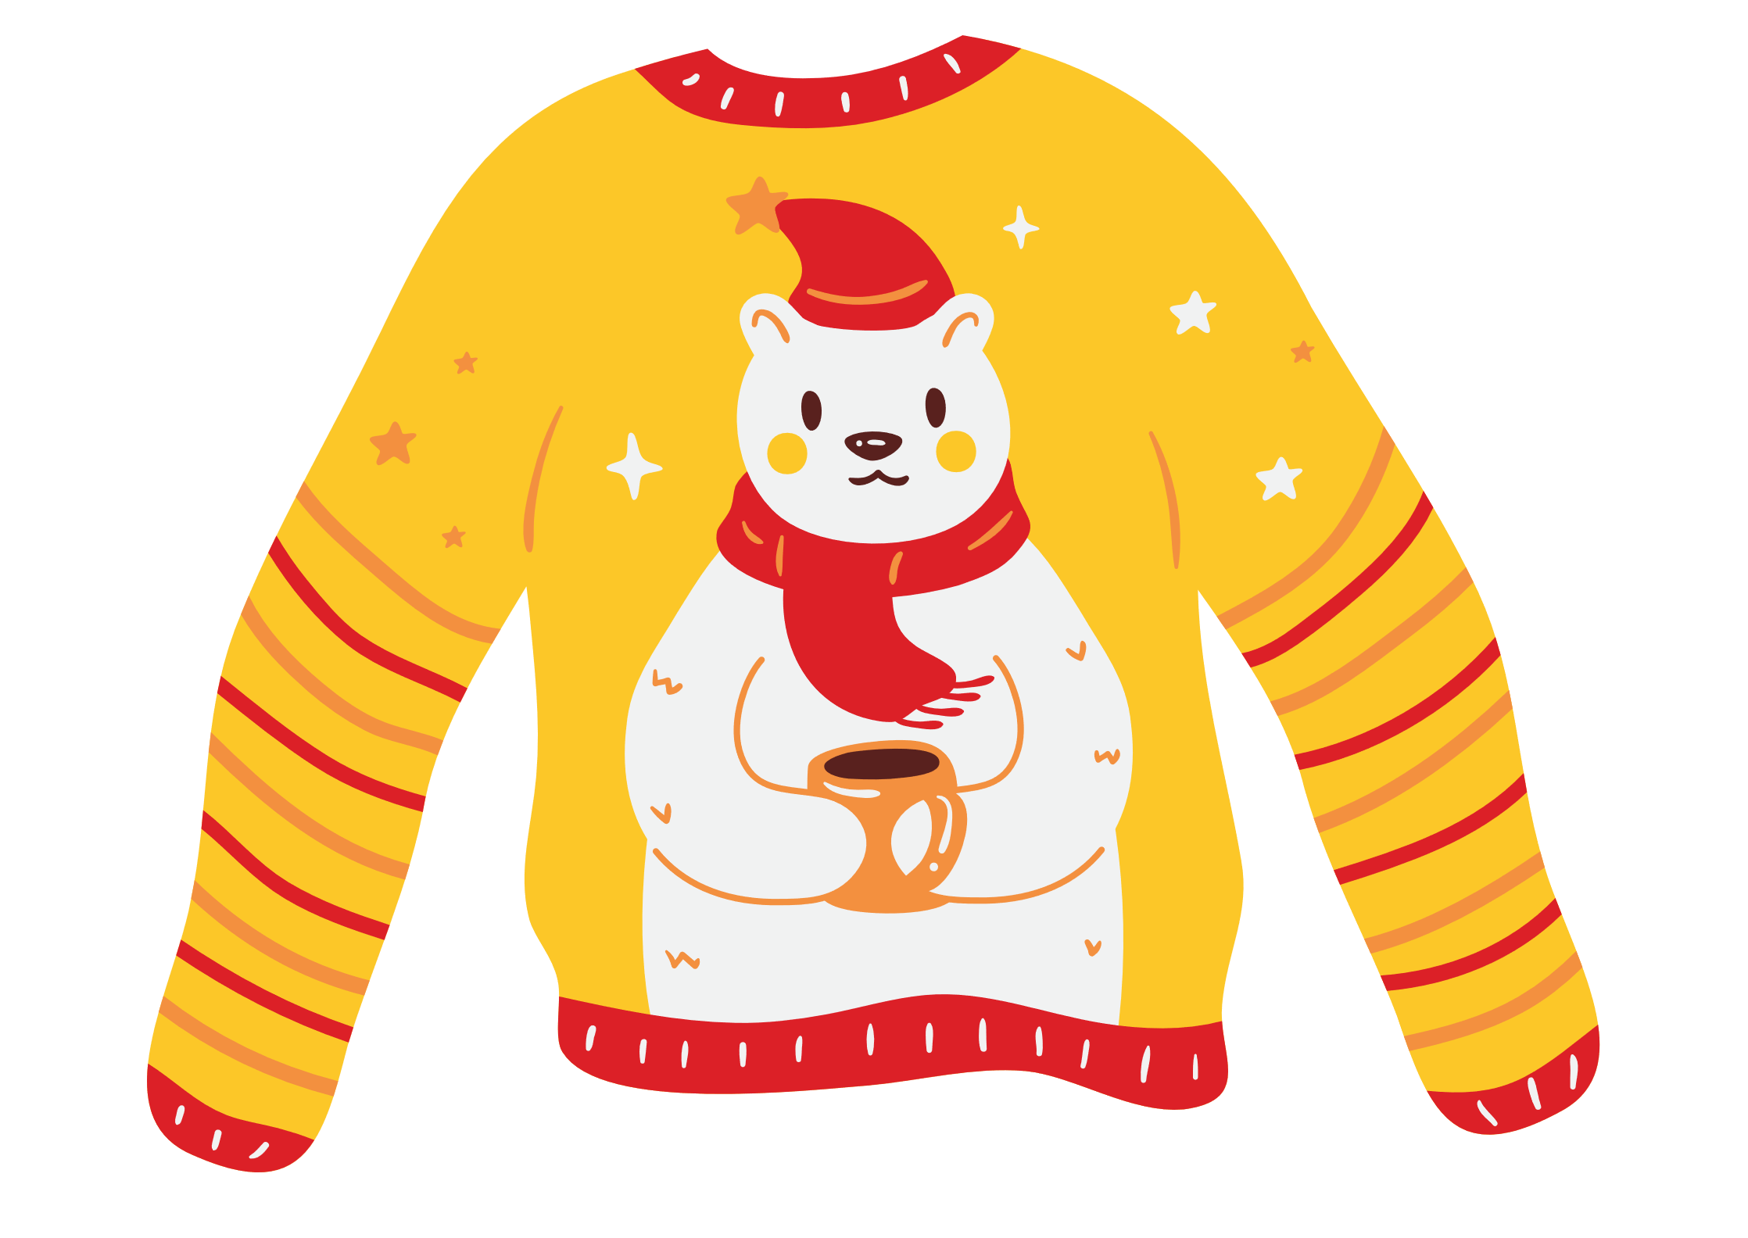
VALID UNTIL 31 DEC 2024
This voucher is not redeemable for cash and cannot be replaced
if it is lost, stolen, or destroyed.

