Slide 1
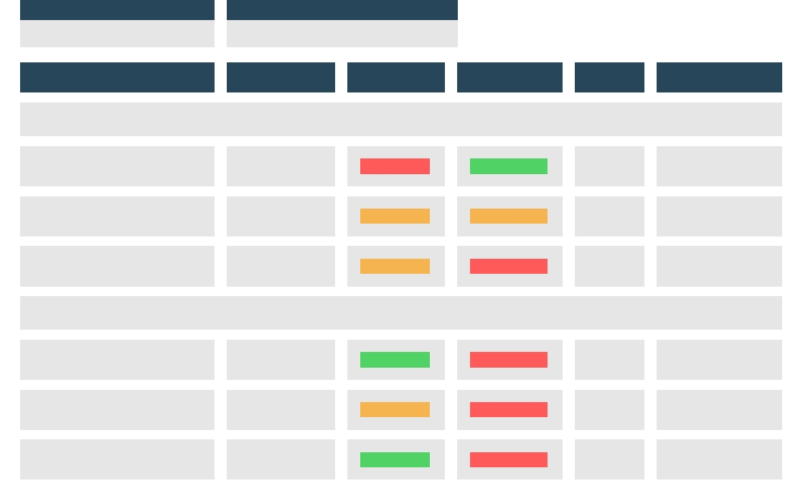
Business Action Plan
PROJECT NAME
PROJECT MANAGER
Energy Tracking System
Merwin Robertson
ACTION
RESPONSIBLE
PRIORITY
STATUS
DEADLINE
RISKS
GOAL: Form Energy Planning System
Include energy requirements in new LDF document and revised DFR18
Brian Hediger
High
Finished
15/08/2023
Waiting for a new law on energy consumption limits
Require energy assessment for major applications used in our factory
John Doe
Medium
In progress
20/08/2023
-
Set standards for major schemes
Gabriel Fonteyn
Medium
Not Started
02/09/2023
-
GOAL: Energy Monitoring System Upgrade
Gather current information and find gaps in monitoring system
Noah Highland
Low
Not Started
05/09/2023
-
Identify scope/benefits of energy management software upgrades
Hugh Norris
Medium
Not Started
11/09/2023
-
Implement required software upgrades in the software (external company engagement)
Warren Smith
Low
Not Started
18/09/2023
-
© TemplateLab.com

