Slide 1
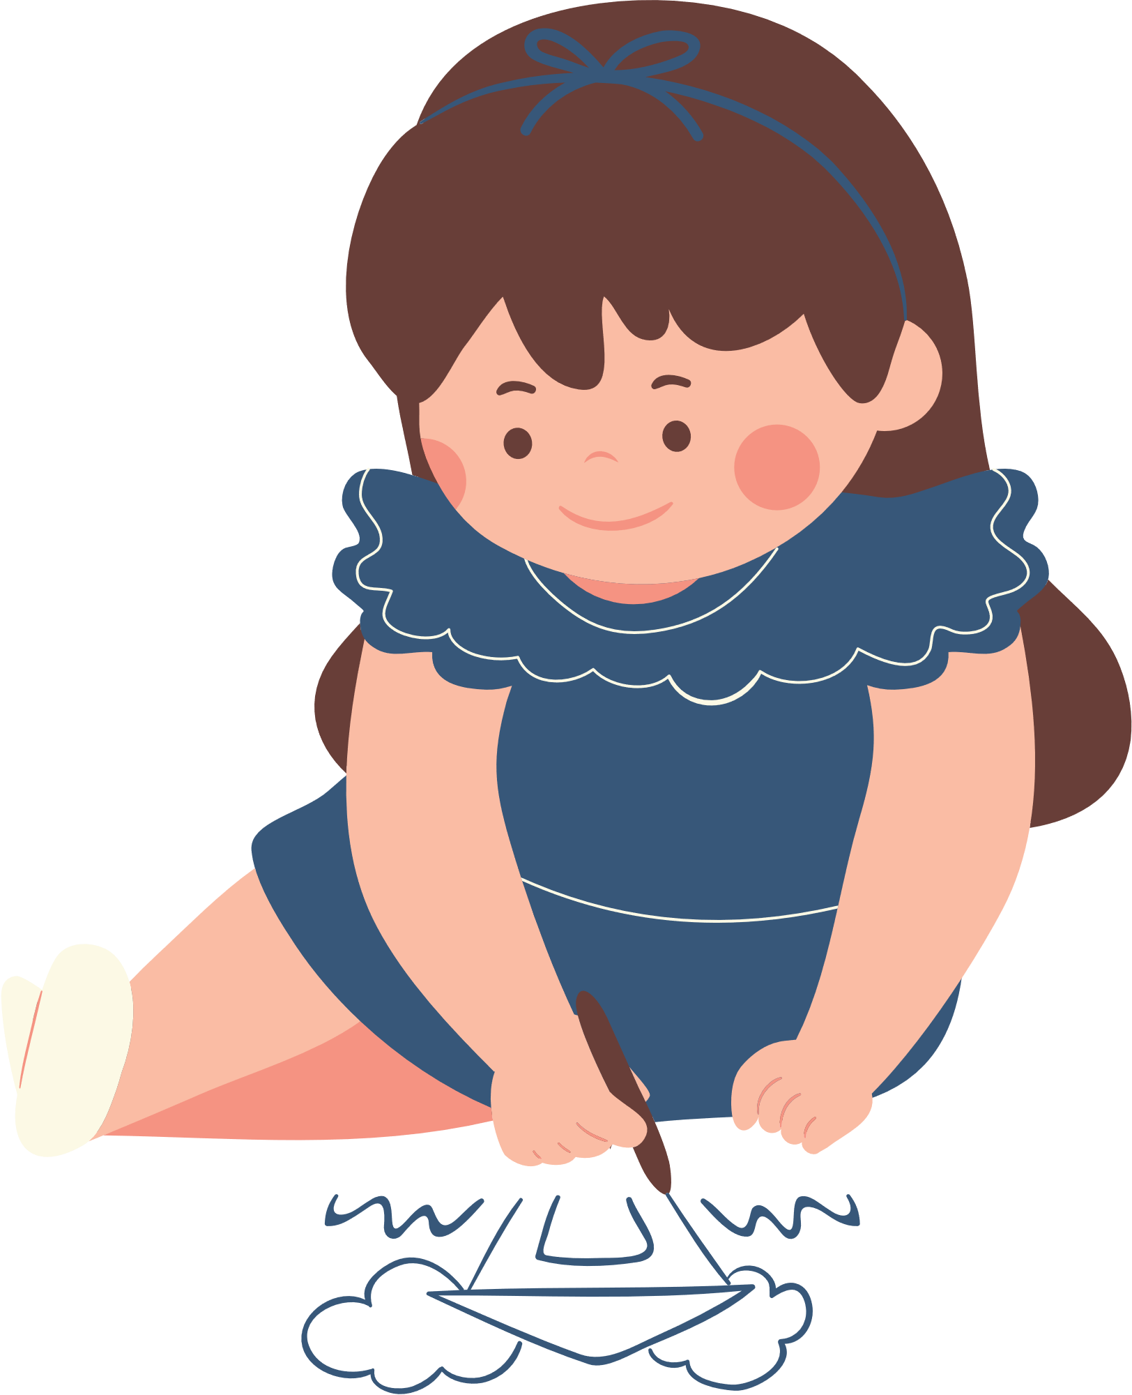
STORY MAP FOR KIDS
Setting
Characters
Beginning
Middle
End

