Slide 1
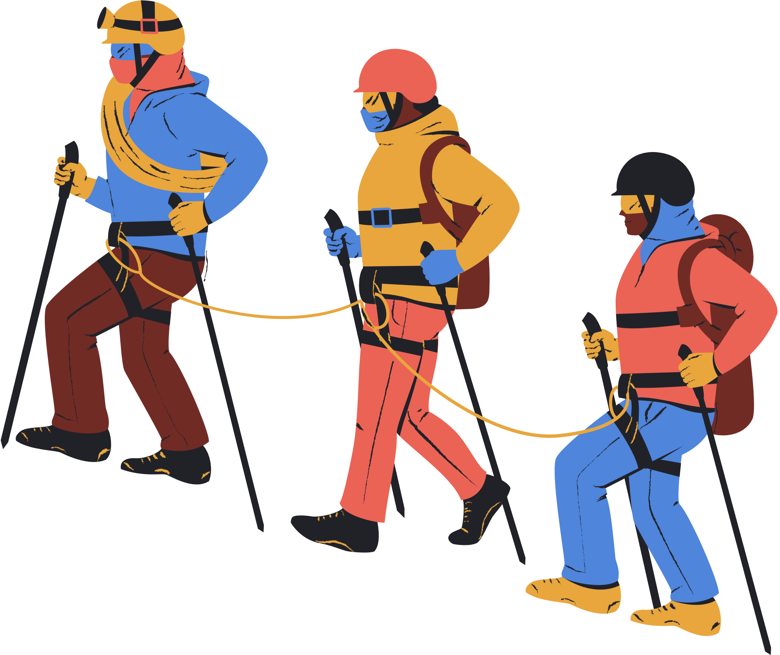
ADVENTURE STORY MAP
Setting
Characters
Elara Island, a mysterious, uncharted island in the 1800s
Protagonist: Jack, an ambitious explorer
Sidekick: Lucy, Jack's resourceful friend
Antagonist: Captain Black, a ruthless pirate
Title
Quest
The Lost Treasure of Elara Island
To find and recover the legendary lost treasure of Elara Island
Climax
Obstacles
Jack and Lucy face off against Captain Black to claim the treasure
1. Unraveling clues and ancient maps
2. Navigating treacherous terrain (jungles, mountains, caves)
3. Encountering dangerous wildlife
4. Evading or confronting Captain Black and his pirate crew
Resolution
Jack and Lucy outsmart Captain Black, recover the treasure, and escape the island

