Slide 1
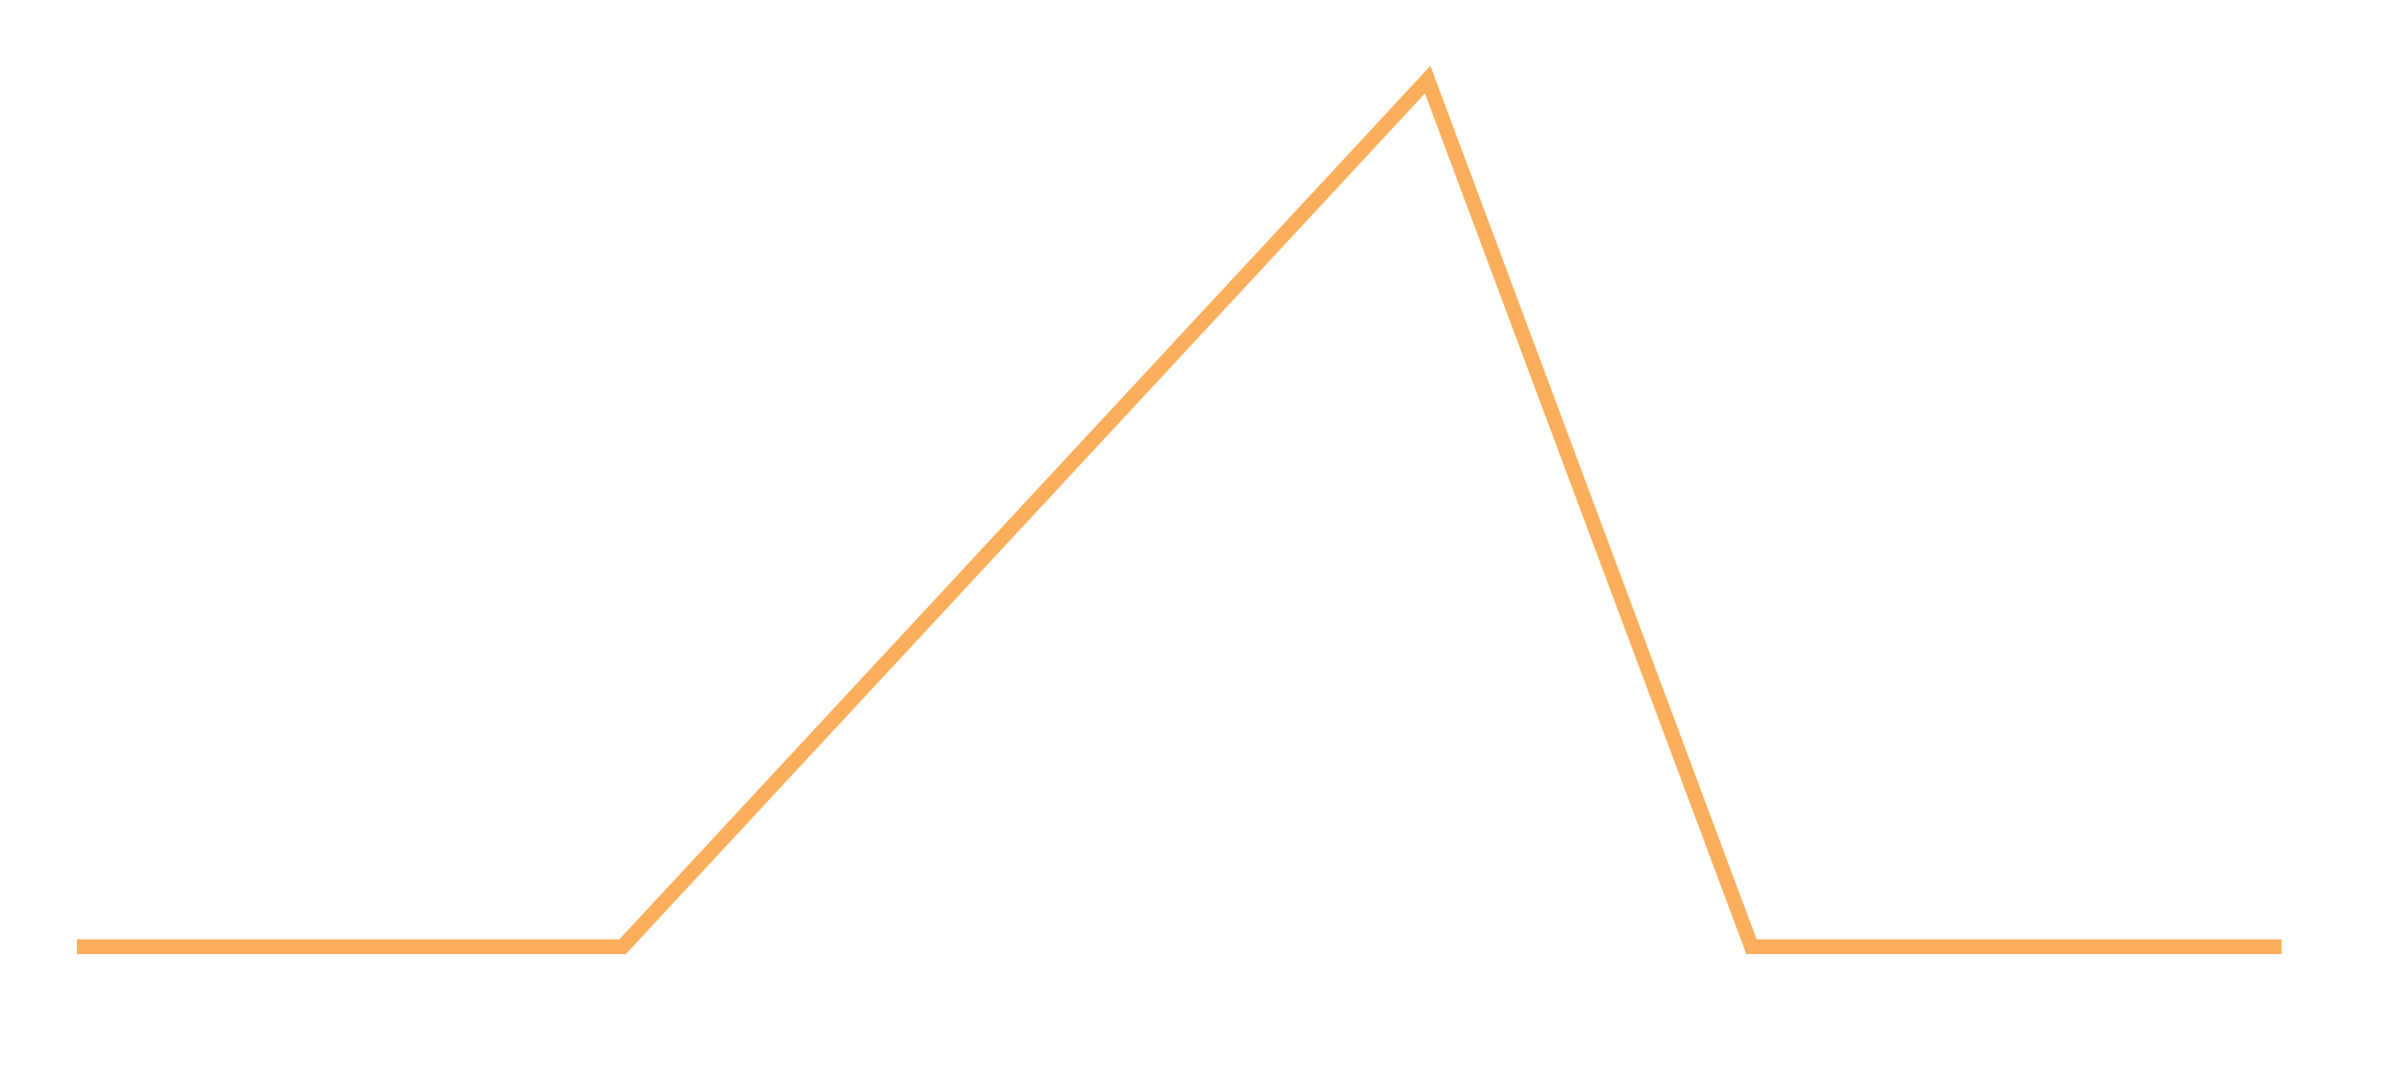
Story Plot Diagram
RISING ACTION
FALLING ACTION
CONFLICT
EXPOSITION
RESOLUTION
BEGINNING
MIDDLE
END

