Slide 1
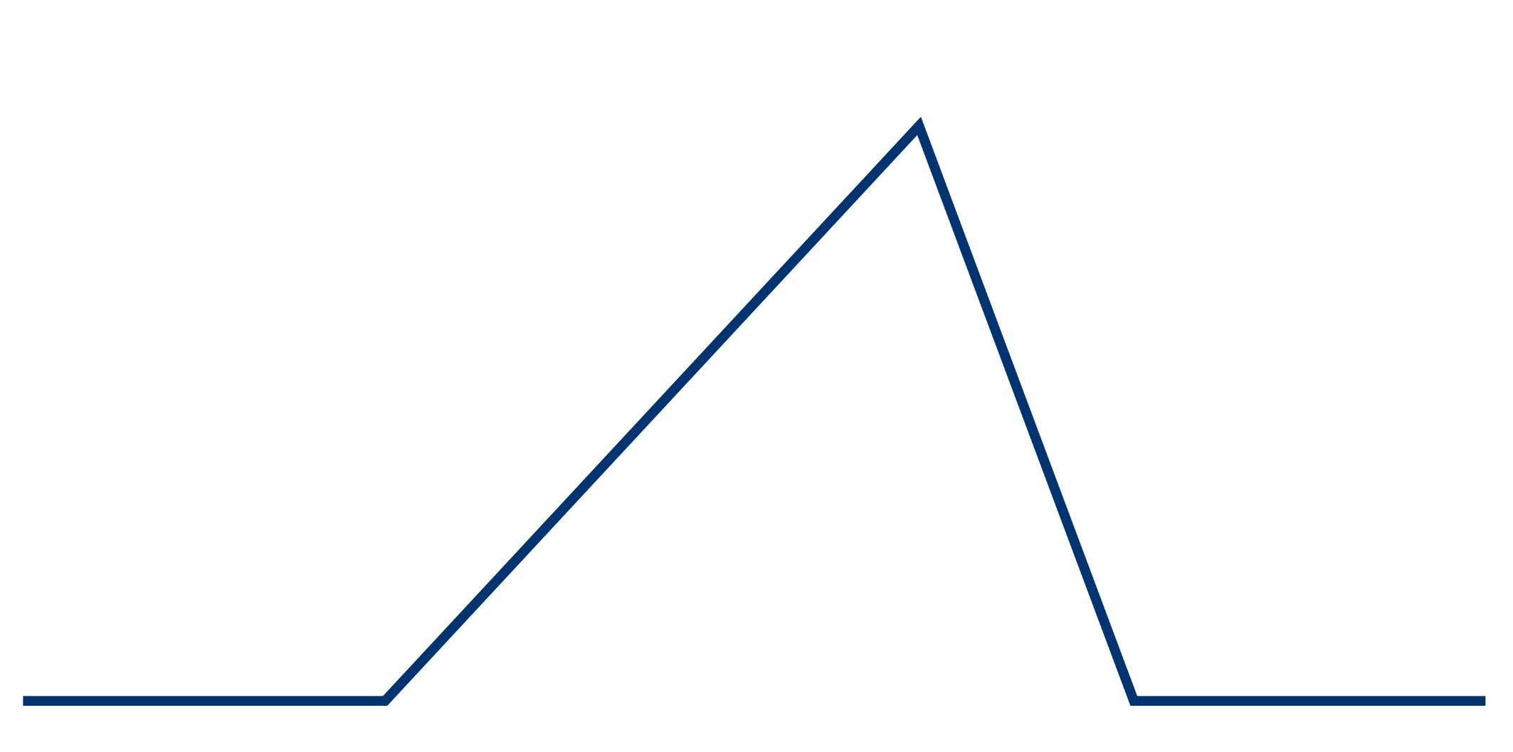
STORY PLOT DIAGRAM
RISING ACTION
FALLING ACTION
CONFLICT
EXPOSITION
RESOLUTION
BEGINNING
MIDDLE
END

