Slide 1
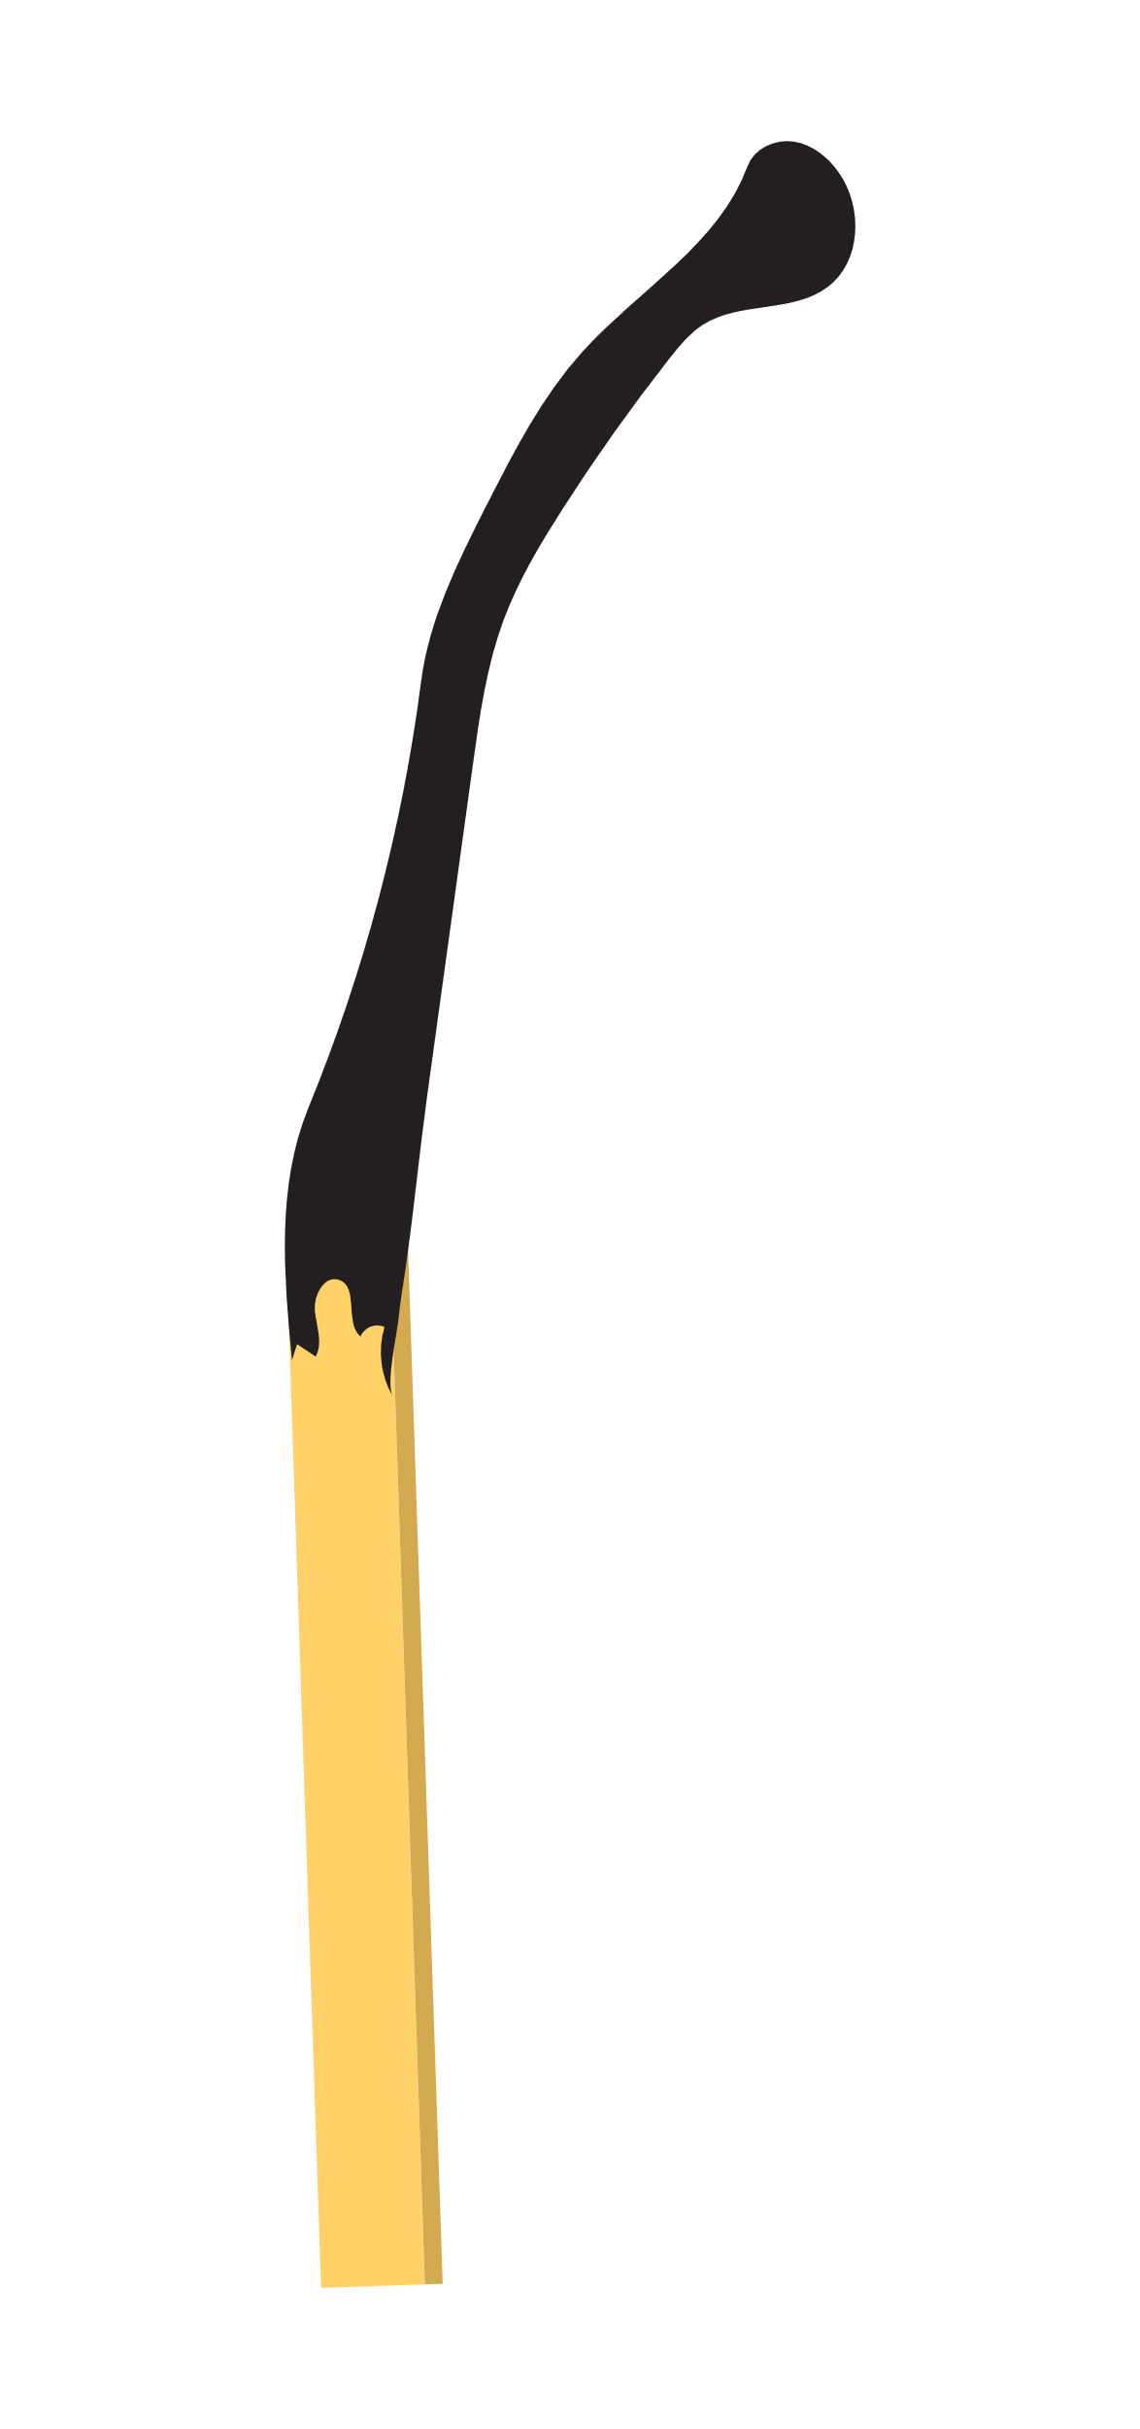
PLOT MOUNTAIN DIAGRAM
CLIMAX
RISING ACTION
FALLING ACTION
EXPOSITION
RESOLUTION
BEGINNING
MIDDLE
END
"LITTLE RED RIDING HOOD"
CLIMAX
EXPOSITION
A woodsman hears the commotion and saves Little Red Riding Hood and her grandmother from the wolf's stomach by cutting open the wolf's belly.
Little Red Riding Hood is introduced as a young girl who is asked by her mother to bring food to her grandmother who lives in the woods. The wolf is also introduced as a character who is hungry and looking for food.
FALLING ACTION
Little Red Riding Hood and her grandmother recover from the experience, and the woodsman kills the wolf. They vow to be more careful in the future and never trust strangers.
RISING ACTION
Little Red Riding Hood meets the wolf in the woods and tells him where she is going. The wolf tricks her and goes to the grandmother's house first, where he eats her and dresses up in her clothing. When Little Red Riding Hood arrives, the wolf pretends to be her grandmother and eats her too.
RESOLUTION
Little Red Riding Hood and her grandmother live happily ever after, having learned a valuable lesson about the dangers of the woods and the importance of caution.

