Slide 1
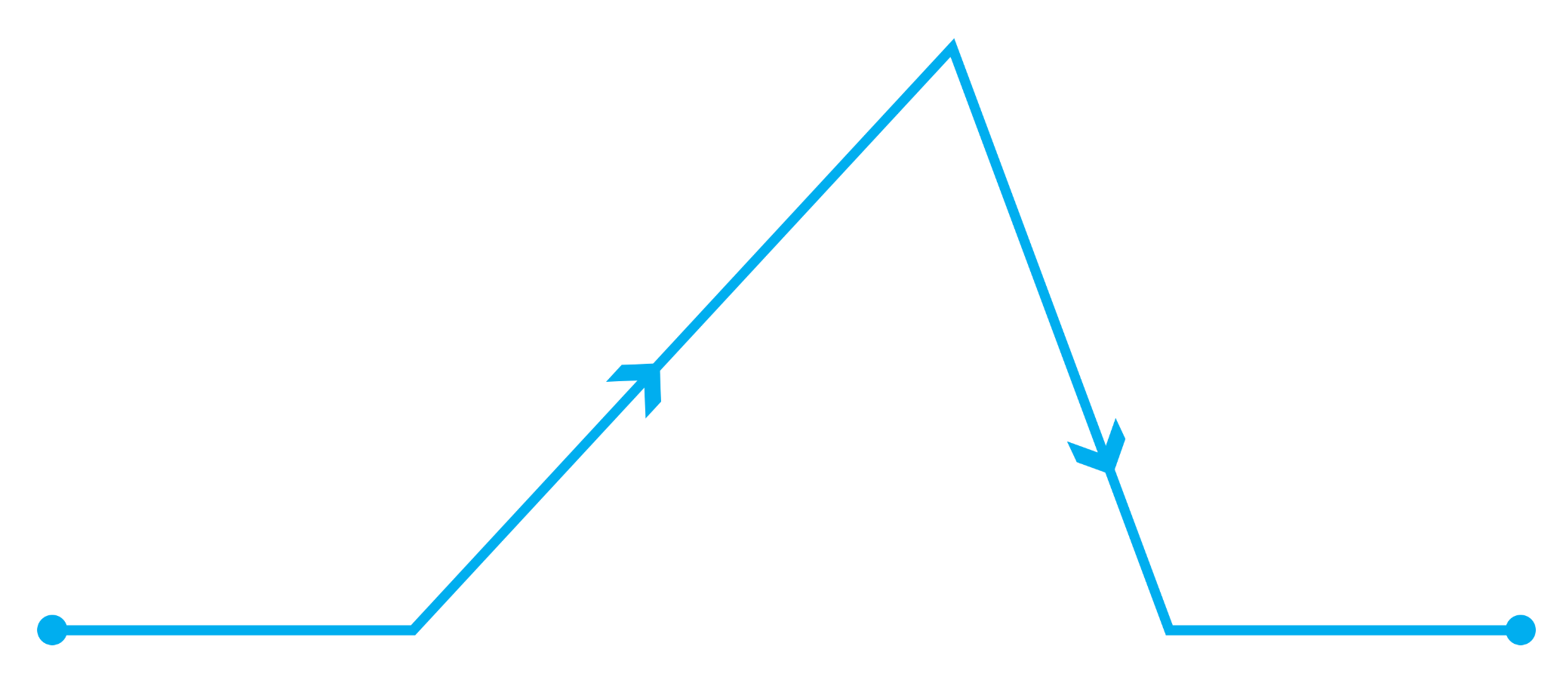
PLOT CHART DIAGRAM
RISING ACTION
FALLING ACTION
CONFLICT
EXPOSITION
RESOLUTION
BEGINNING
MIDDLE
END

