Slide 1
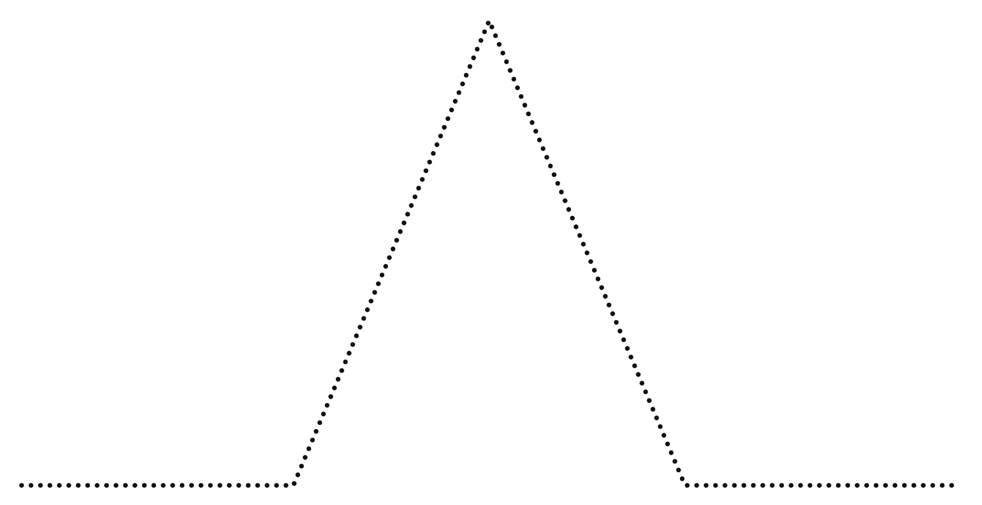
MOVIE PLOT DIAGRAM
CLIMAX
3
2
RISING ACTION
FALLING ACTION
4
1
EXPOSITION
RESOLUTION
5

