Slide 1
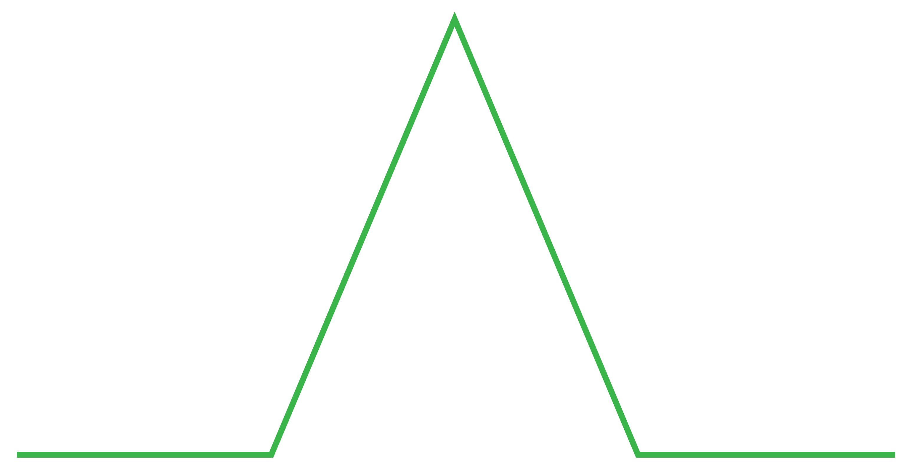
Linear
plot
DIAGRAM
PROBLEM
FALLING ACTION
EXPOSITION
RESOLUTION
BEGINNING

