Slide 1
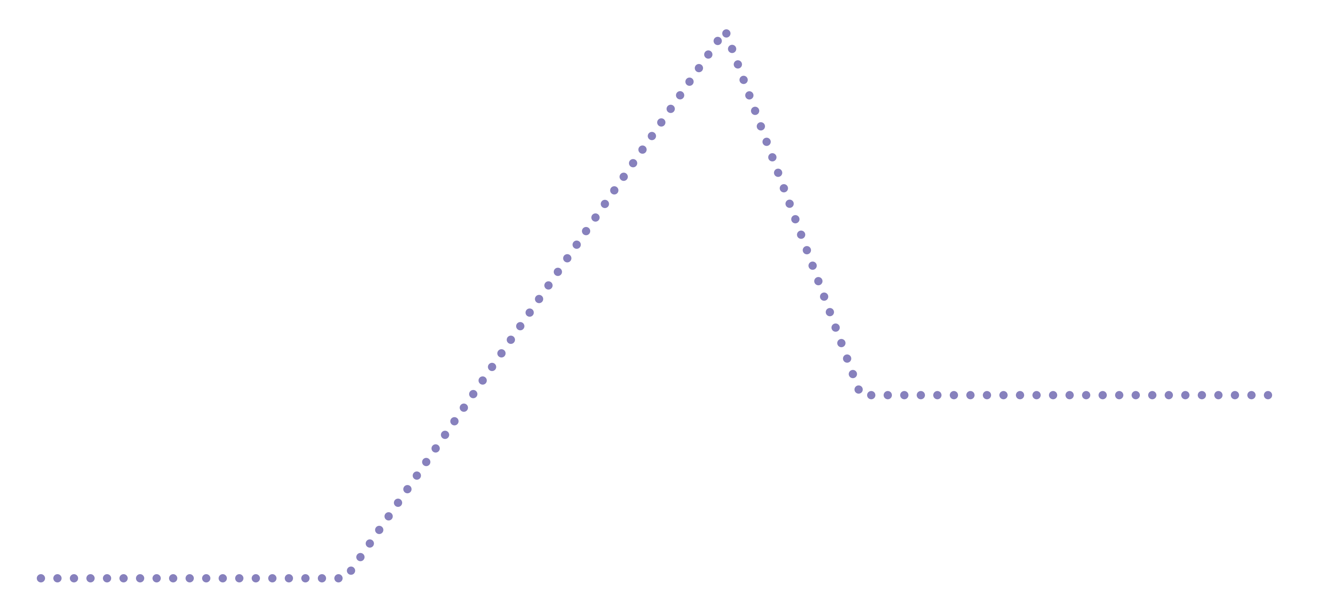
Book Plot
Diagram
CLIMAX
3
FALLING ACTION
4
2
RISING ACTION
RESOLUTION
5
1
EXPOSITION

