Slide 1
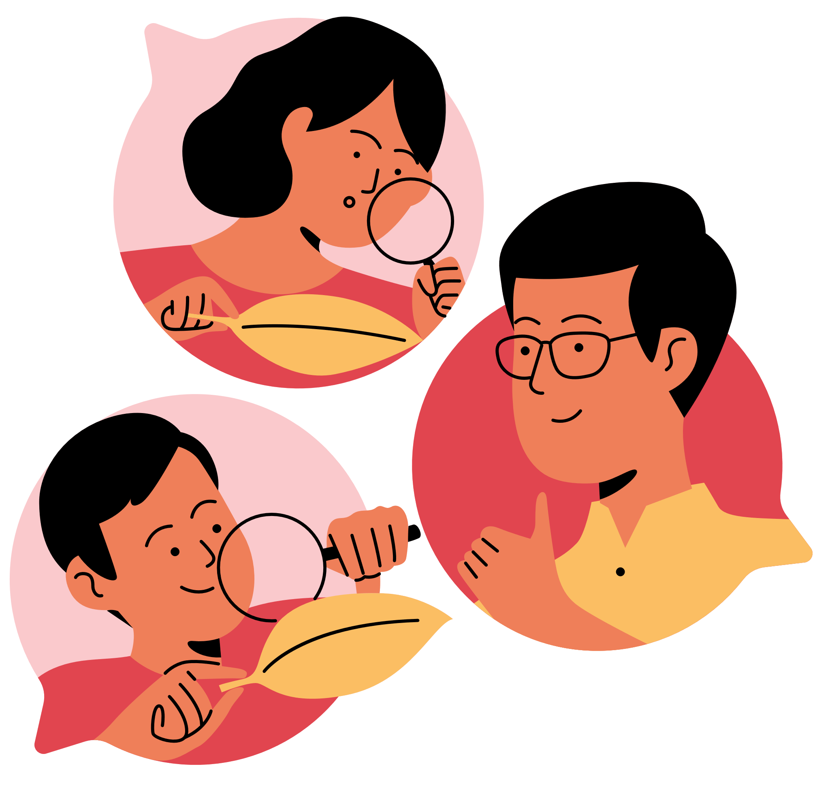

MIDDLE SCHOOL HOMEWORK
CLASS
TASK
DUE

