Slide 1
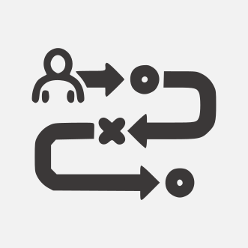
COMPANY NAME
Quality Assurance Work Breakdown Structure
Analyze Requirements
Analyzing and defining software requirements, both functional and non-functional. QAs must be offered consistent, comprehensive, traceable requirements and clearly marked.
Timeline:
01/05/2023-17/06/2023
Plan the tests
Timeline:
The test plan should comprise the software testing strategy, the scope of testing, the project budget, and established deadlines. It should also outline the types and levels of testing required, methods, and tools for tracking bugs.
18/06/2023-22/06/2023
Design the tests
QA teams have to craft test cases and checklists that encompass the software requirements at this stage. Each test case must contain conditions, data, and the steps needed to validate each functionality. Every test must also define the expected test result.
Timeline:
23/06/2023-14/07/2023
Execute Tests and Report
Defects
Timeline:
Tests start at the unit level with developers performing unit tests. Then, the quality
assurance testing team runs tests at API and UI levels. All bugs detected are submitted in a defect tracking system for effective defect
management.
15/07/2023-31/07/2023
Run Re-Tests and Regression
Tests
Once bugs have been found, submitted, and fixed, QAs test the functions again to ensure that they didn’t miss any anomalies. They also run regression tests to verify that the fixes have not affected the existing functions.
Timeline:
01/08/2023-15/08/2023
Run Release Test
Timeline:
A release notification is released with a list of already implemented features, fixed bugs,
recurring issues, and limitations, the QA team must identify the functionalities
affected by these changes. Then, the team must design modified test suites.
16/08/2023-20/08/2023
© TemplateLab.com

