Slide 1
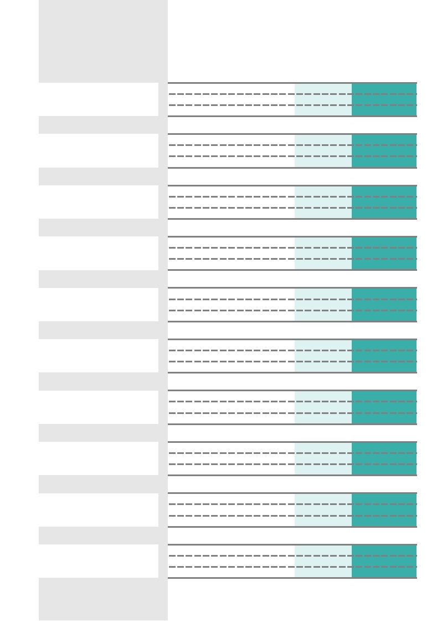
PHASES
BUSINESS ACQUISITION
Work Breakdown Structure
TASK DEADLINE RESPONSIBLE
01
Plan an acquisition strategy
Set up goal
Jan 09, 2023
S.Dilbert
Benefits listed
Jan 14, 2023
B. Elora
Define acquisition type
Jan 22, 2023
S. Dilbert
02
Establish the search criteria for the opportunity
Management can be improved
Feb 05, 2023
M. Willson
Lack of treasury to be covered
Feb 08, 2023
M. Willson
International expansion opportunity
Feb 22, 2023
Y. Hammer
03
Search for potential targets
Analyse objectives condition
Feb 27, 2023
M. Willson
Opportunities offered by banks
Mar 02, 2023
M. Willson
Professional references
Mar 04, 2023
Y. Hammer
04
Planning the transaction
Contacting companies
Mar 15, 2023
N. Pikachu
Assess the potential companies
Mar 31, 2023
G. Beavis
NDA agreements handling
Apr 10, 2023
D. Castiel
05
Analysis of the company
Ask for additional information
Apr 20, 2023
A. Fester
Evaluate the potential acquisition
Apr 30, 2023
A. Fester
Financial statements examination
May 06, 2023
Y. Hammer
06
LOI (Letter of Intent) and Negotiations
First offer (non-binding)
May 11, 2023
T. Dagwood
More detailed negotiations
May 25, 2023
R. Yoda
Binding offer
May 31, 2023
Z. Merida
07
Due Diligence
Confirm or correct the evaluation
Jun 04, 2023
U. Challa
Due diligence report creation
Jun 20, 2023
B. Harris
Offer corrections (Final offer)
Jun 25, 2023
L. Loyd
08
Drafting of contracts and other transaction documents
Payment method and guarantees
Jul 08, 2023
J. Nakashima
Power sharing definition
Jul 12, 2023
W. Johnson
How to retain key people
Jul 18, 2023
S. Paris
09
Finance for the operation
Stable cash flow management
Jul 25, 2023
F. Sonic
Investment program definition
Jul 30, 2023
A. Wednesday
Amount of funds needed defined
Aug 10, 2023
M. Poup
10
Closing and integration for the acquisition
Signing of the commercial operation
Aug 28, 2023
H. Morris
The effective integration
Sep 10, 2023
V.Gage
Internal protocols revisions
Sep 30, 2023
B. Barton
© TemplateLab.com

