Slide 1
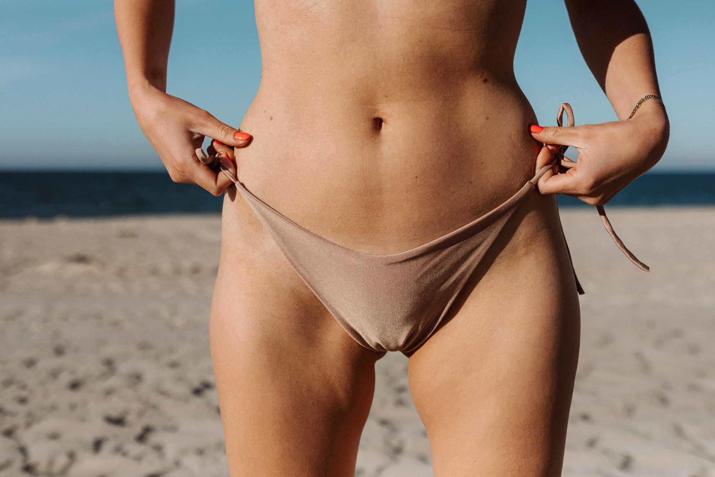

MAY 2025
SUMMER
NEWSLETTER
Dear valued clients,
Summer is here and we hope you're all enjoying the sun, sand, and surf! We wanted to update you on our latest collections and share some exciting news.
READ MORE

Slide 2
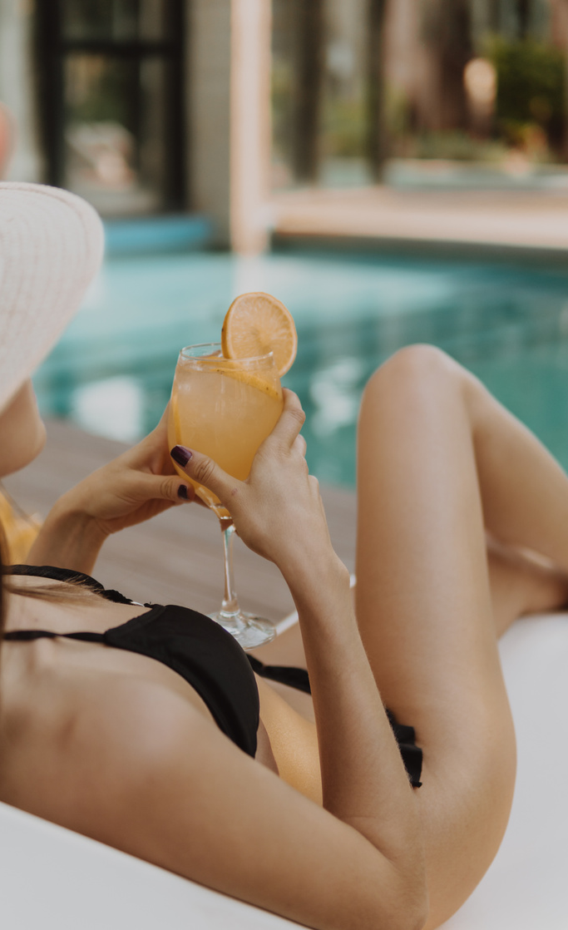
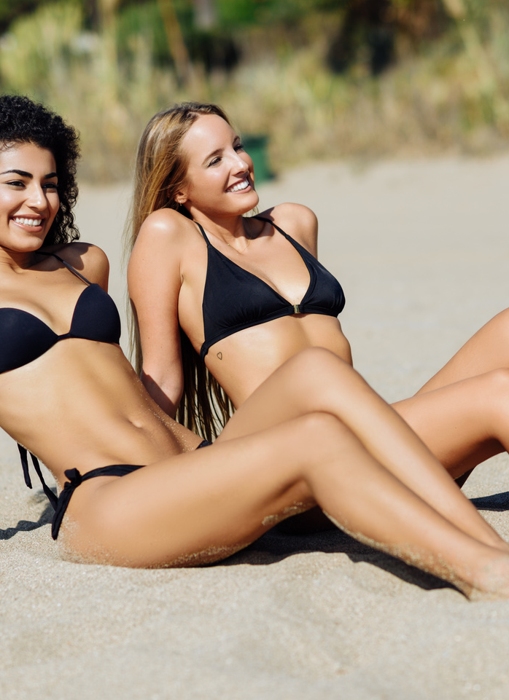
NEW ARRIVALS
Check out our latest bikini collections, featuring bold prints, vibrant colors, and stylish designs. We've added new styles and sizes to suit every body type, so you can find the perfect bikini for your summer adventures. Whether you're hitting the beach, lounging by the pool, or jetting off to a tropical destination, we've got you covered.
SEE MORE
SUMMER SALE
Looking for a great deal? Don't miss our summer sale, featuring discounts on select items from our collections. Get up to [Percentage or dollar amount] off your favorite bikinis and accessories, and stock up for the rest of the season. Hurry, these deals won't last forever!
SEE MORE
www. templateLAB.com

