Slide 1
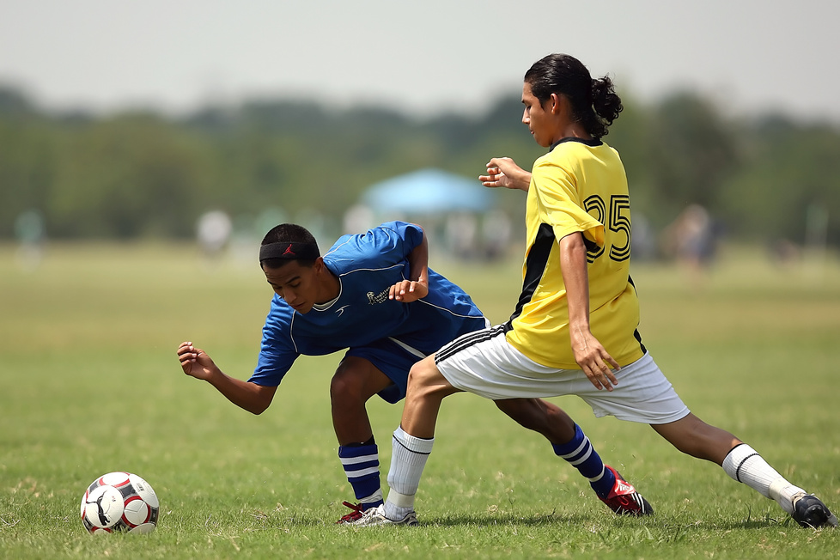
School
newsletter
Library News
We're excited to announce that our school library is now open every day during lunch and after school until 4 pm. Our librarian is available to help students find books, work on research projects, or just relax and read. In addition, we have a fantastic collection of books, including new releases, graphic novels, and non-fiction titles. Come and check out all the resources our library has to offer!
Reminders
Please set aside some of your money to prepare for a tour to the museum in the even semester
Join a volunteer organization to help others
Events
May. 17
May. 24
Quality educational webinars
Art and Picture day
May. 20
May. 30
Check the health of all students
Science fair

