Slide 1
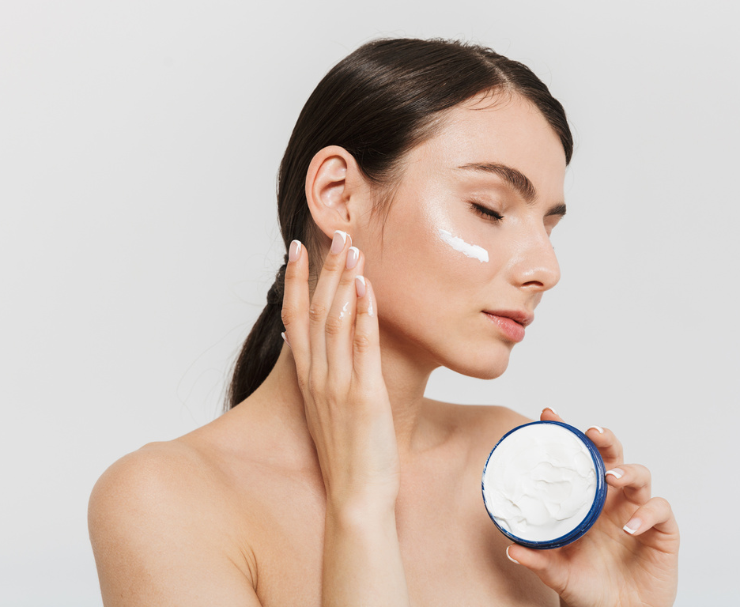
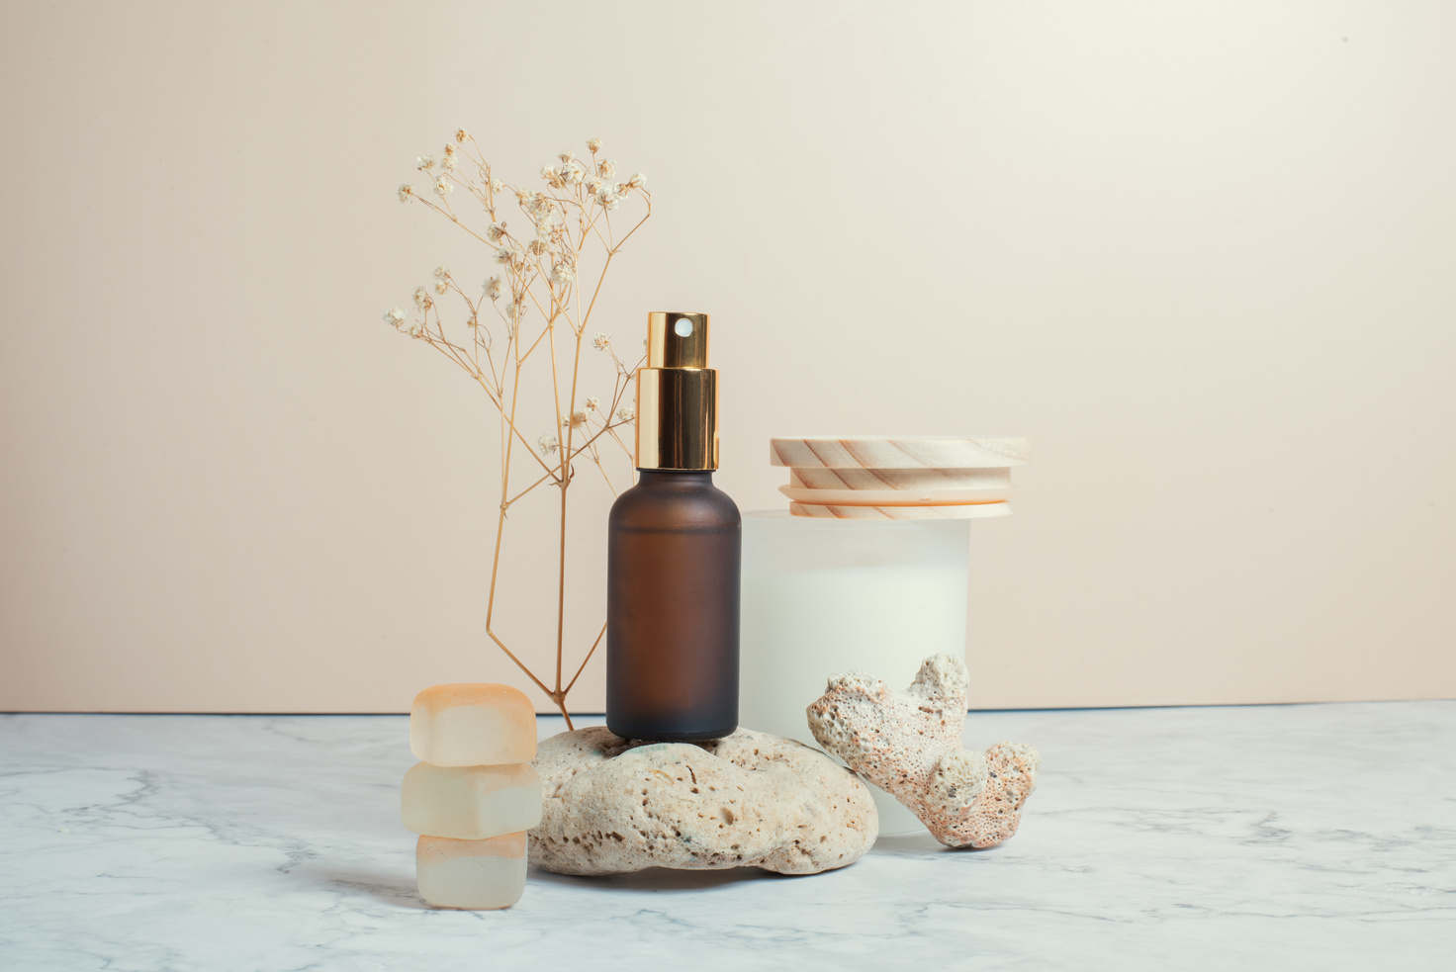
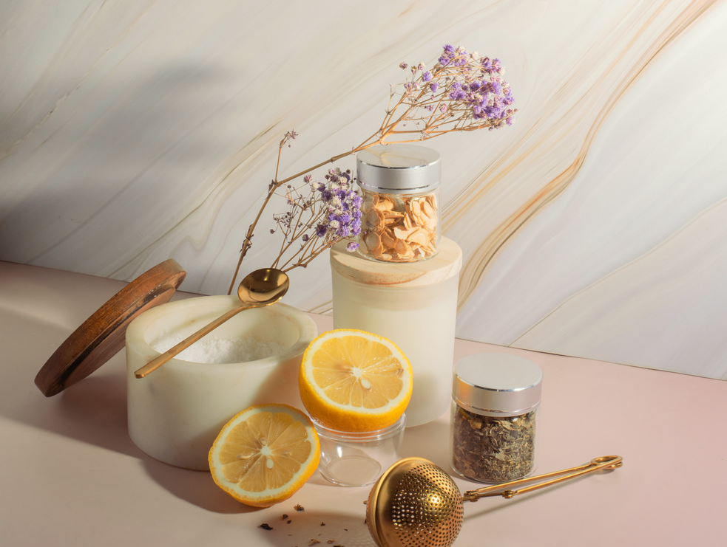
january - 2023
COMPANY NAME
MONTHLY NEWSLETTER
New Organic Skincare Product
For that, we are organic skincare that brings the goodness of nature. This skincare contains ingredients derived from organic plants grown and cultivated by us.
SHOP NOW
our latest product
Going back to nature is one of the best ways to maintain healthy skin. This exclusive product is suitable for those of you who want to treat your skin in a natural but effective way.
SHOP NOW
www.companyname.com
contact@companyname.com

