Slide 1
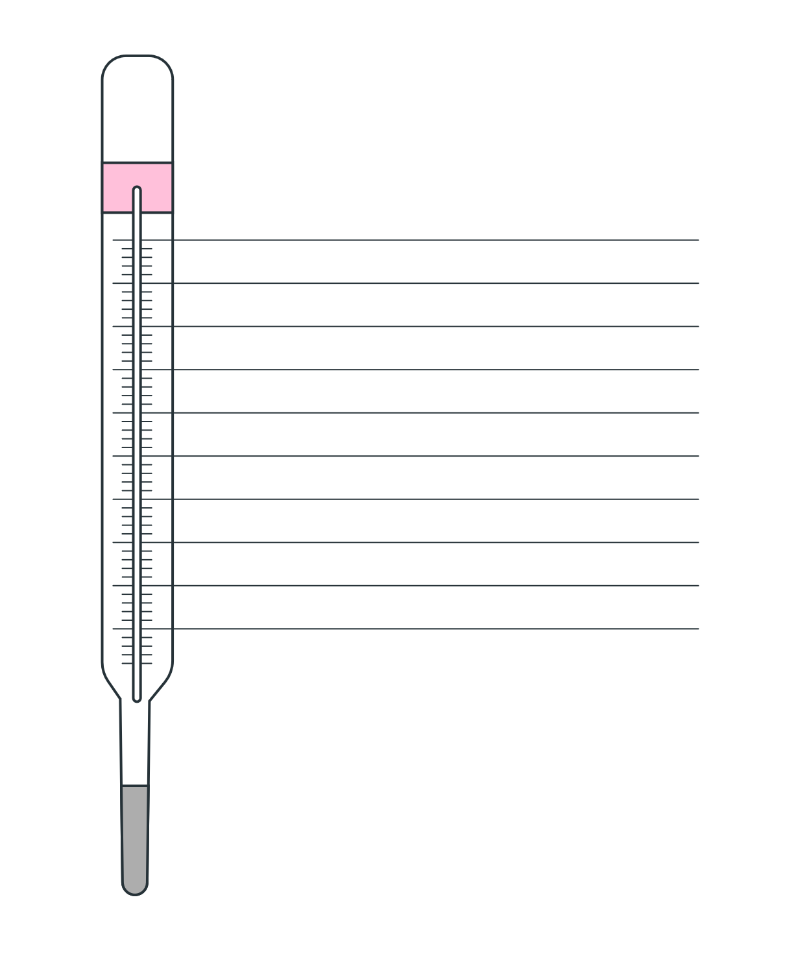

Thermometer goal chart
100%
90%
80%
70%
60%
50%
40%
30%
20%
10%
GOAL
AMOUNT
START DATE
END DATE

