Slide 1
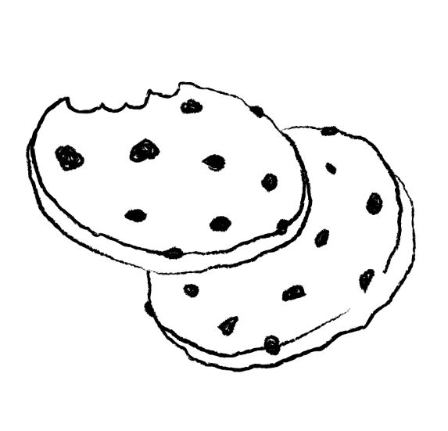
Girl Scout Cookies
SALES GOAL
GOAL!
ALMOST THERE
GREAT
Awesome
Keep going
Great job
Start!

