Slide 1
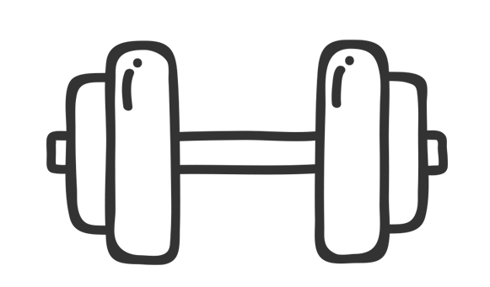
FITNESS GOAL
Monthly Goals
STAY HEALTHY…

