Slide 1
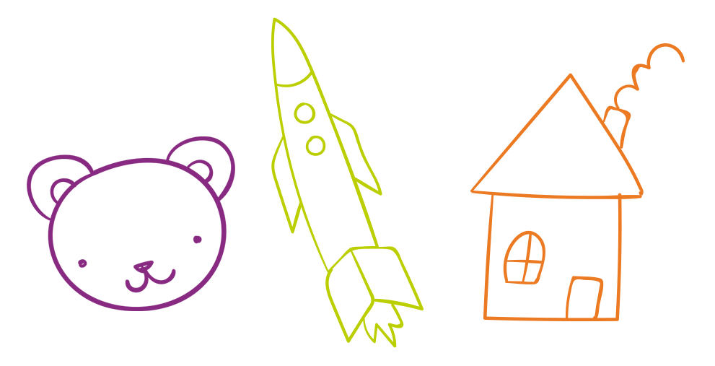
Ashley’s
BEHAVIOR CHART
BEHAVIORS
MON
TUE
WED
THU
FRI
SAT
SUN
I clean up my room
I shared my snacks with my sister
I helped mom cook dinner
I helped my sister
I used please and thank you
I helped feed the dog
I didn’t yell or scream
I didn’t talk back

