Slide 1
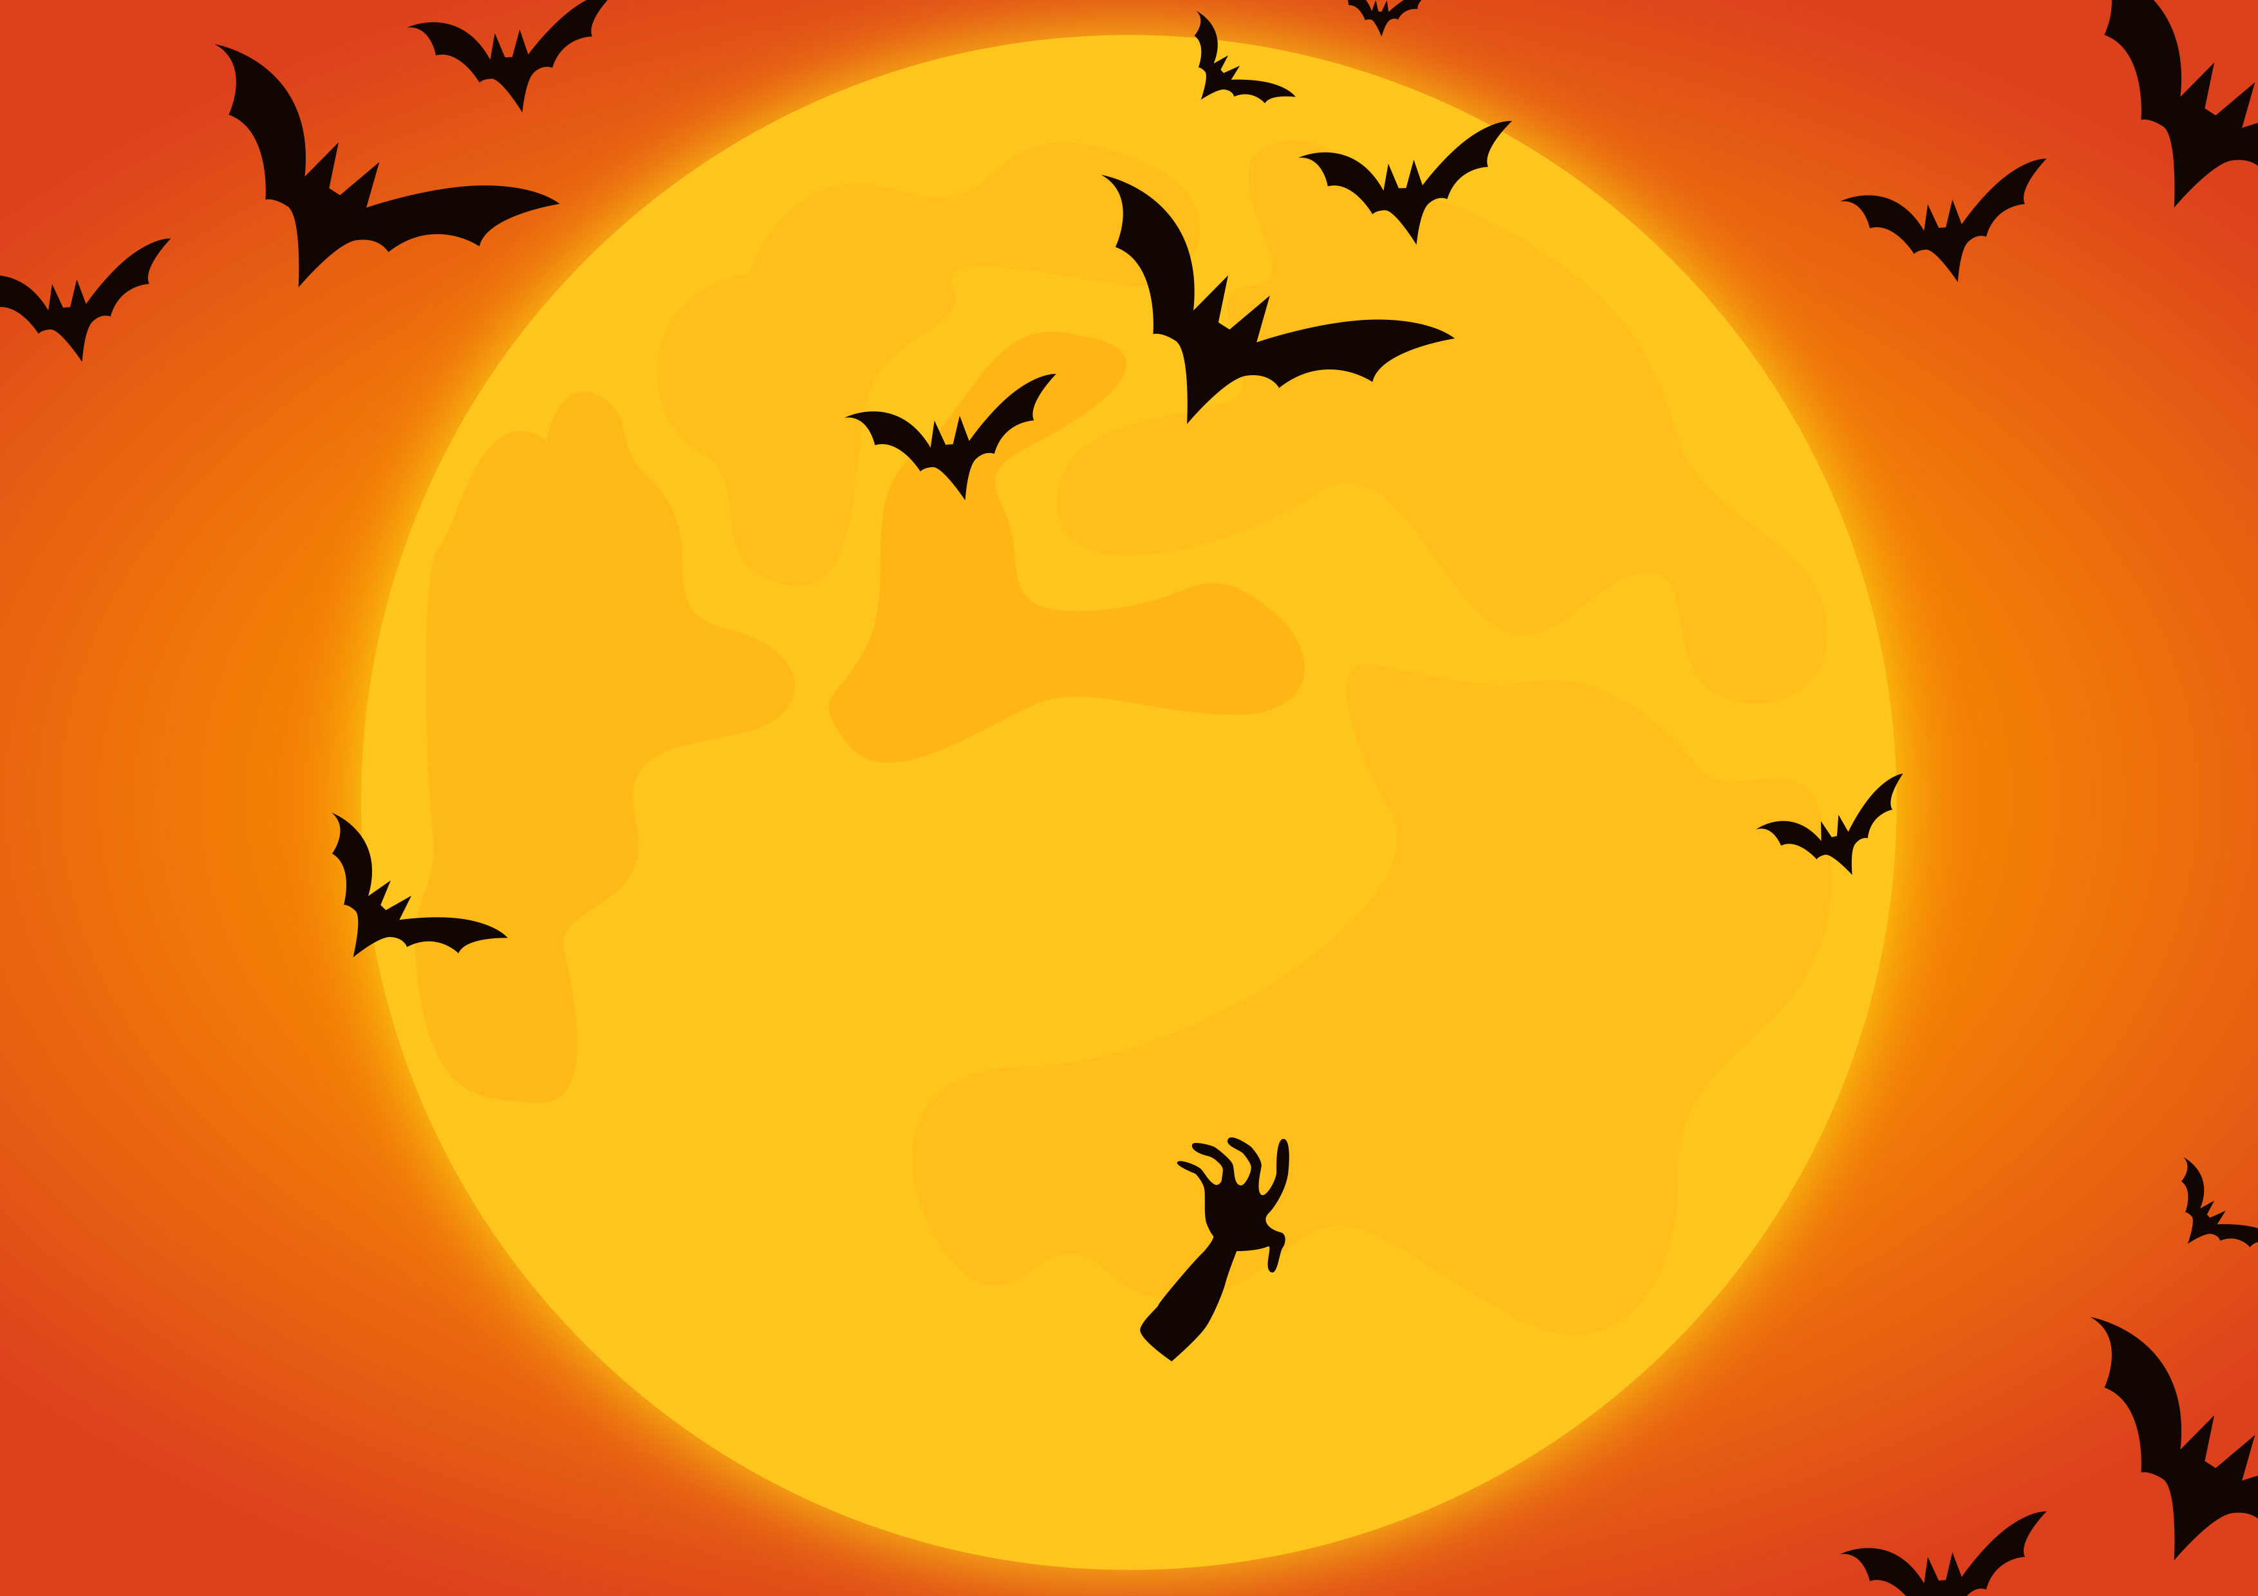
NAME A POPULAR HALLOWEEN MOVIE
HALLOWEEN
32
SCREAM
04
FRIDAY THE 13TH
23
HOCUS POCUS
03
NIGHTMARE ON ELM STREET
20
FRANKENSTEIN
03
IT'S THE GREAT PUMPKIN CHARLIE BROWN
THE ADDAMS FAMILY
13
02

