Slide 1

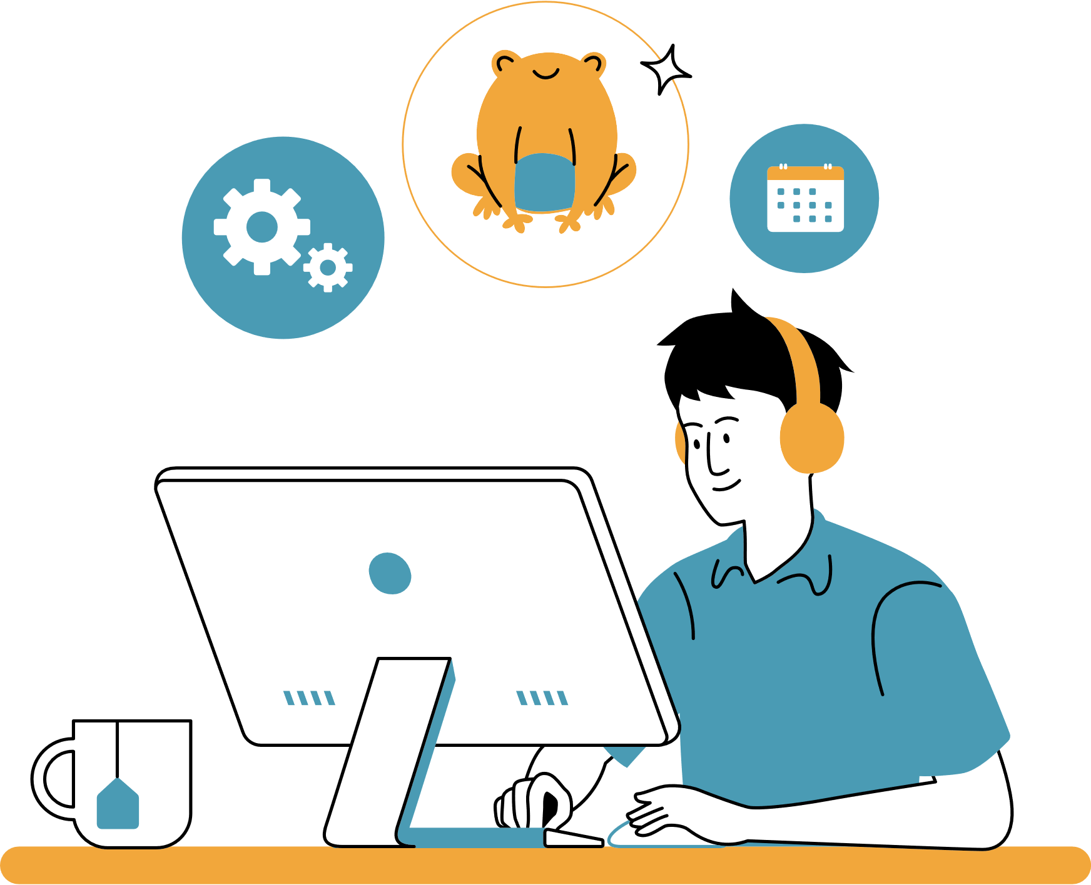

Family feud for work
WHAT IS A COMMON REASON EMPLOYEES MAY COME TO WORK LATE?
Traffic
35
Car trouble
10
Overslept
25
Childcare issues
10
Public transportation delay
15
Medical appointment
5

