Slide 1
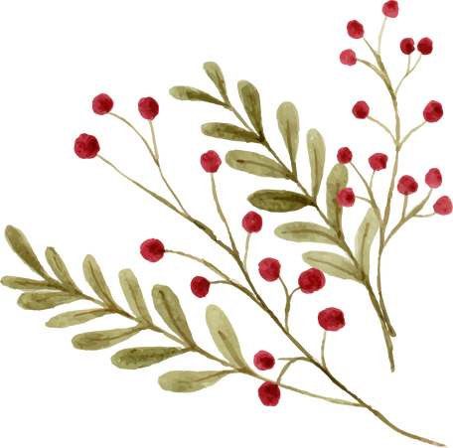

CHRISTMAS FAMILY FEUD
Name something you might find in a Christmas stocking
Name a popular Christmas carol
What's a popular Christmas decoration?
Name a traditional Christmas dinner dish
Name something people do on Christmas Day
TOTAL SCORE

Slide 2
ANSWER SHEET
1. Name something you might find in a Christmas stocking
Candy (35)
Small toys (25)
Fruit (20)
Socks (10)
Gift cards (10)
2. Name a popular Christmas carol
Jingle Bells (30)
Silent Night (25)
White Christmas (20)
O Holy Night (15)
Deck the Halls (10)
3. What's a popular Christmas decoration?
Christmas Tree (40)
Lights (30)
Ornaments (15)
Wreaths (10)
Tinsel (5)
4. Name a traditional Christmas dinner dish
Turkey (30)
Ham (25)
Mashed potatoes (20)
Stuffing (15)
Cranberry sauce (10)
5. Name something people do on Christmas Day
Open presents (40)
Eat a big meal (30)
Visit family (15)
Attend church (10)
Watch Christmas movies (5)

