Slide 1
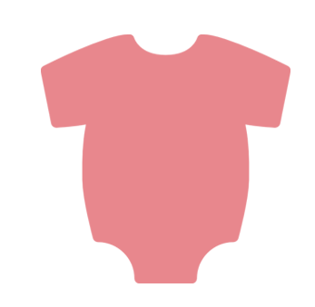
WHAT IS THE BEST TASTING
BABY FOOD FLAVOR?
BANANA
32
CARROTS
12
APPLE
23
PEARS
09
PEACHES
15
APRICOT
05

