Slide 1
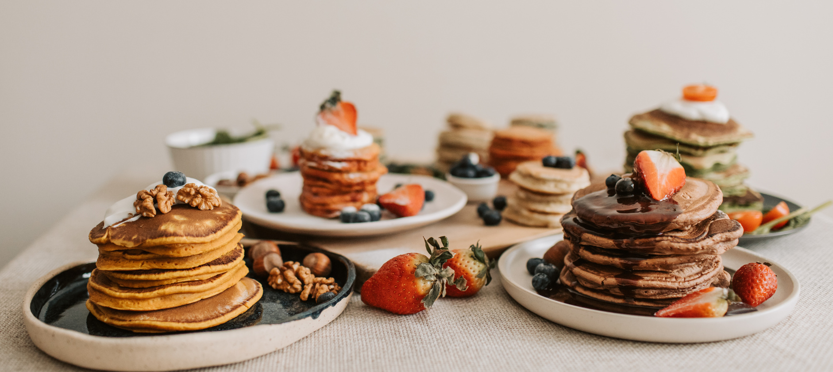
3
PANCAKE
Recipes
SERVINGS
TIME
DIFFICULTY
CALORIES
2
30 min
Easy
1231 kcal
Ingredients
Directions
1 1/2 cups all-purpose flour
3 1/2 teaspoons baking powder
1/2 teaspoon salt
2 tablespoons granulated sugar
1 1/4 cups milk
1 large egg
3 tablespoons unsalted butter, melted
Cooking spray or additional butter for greasing the pan
In a bowl, whisk together flour, baking powder, salt, and sugar.
In a separate bowl, whisk together milk, egg, and melted butter.
Combine the wet and dry ingredients, stirring until just combined. A few lumps are okay.
Preheat a non-stick skillet or griddle over medium heat. Grease the cooking surface with cooking spray or a small amount of butter.
Pour 1/4 cup of batter onto the skillet for each pancake. Cook until bubbles form on the surface, then flip and cook the other side until golden brown.
Repeat with the remaining batter, adding more cooking spray or butter as needed to prevent sticking.
Serve the Pancakes warm with your favorite toppings such as maple syrup, fresh fruits, or whipped cream.
Tips:
For extra flavor, you can add a teaspoon of vanilla extract or a sprinkle of ground cinnamon to the batter.
If you prefer thinner pancakes, you can add a little more milk to the batter to achieve the desired consistency.

