Slide 1
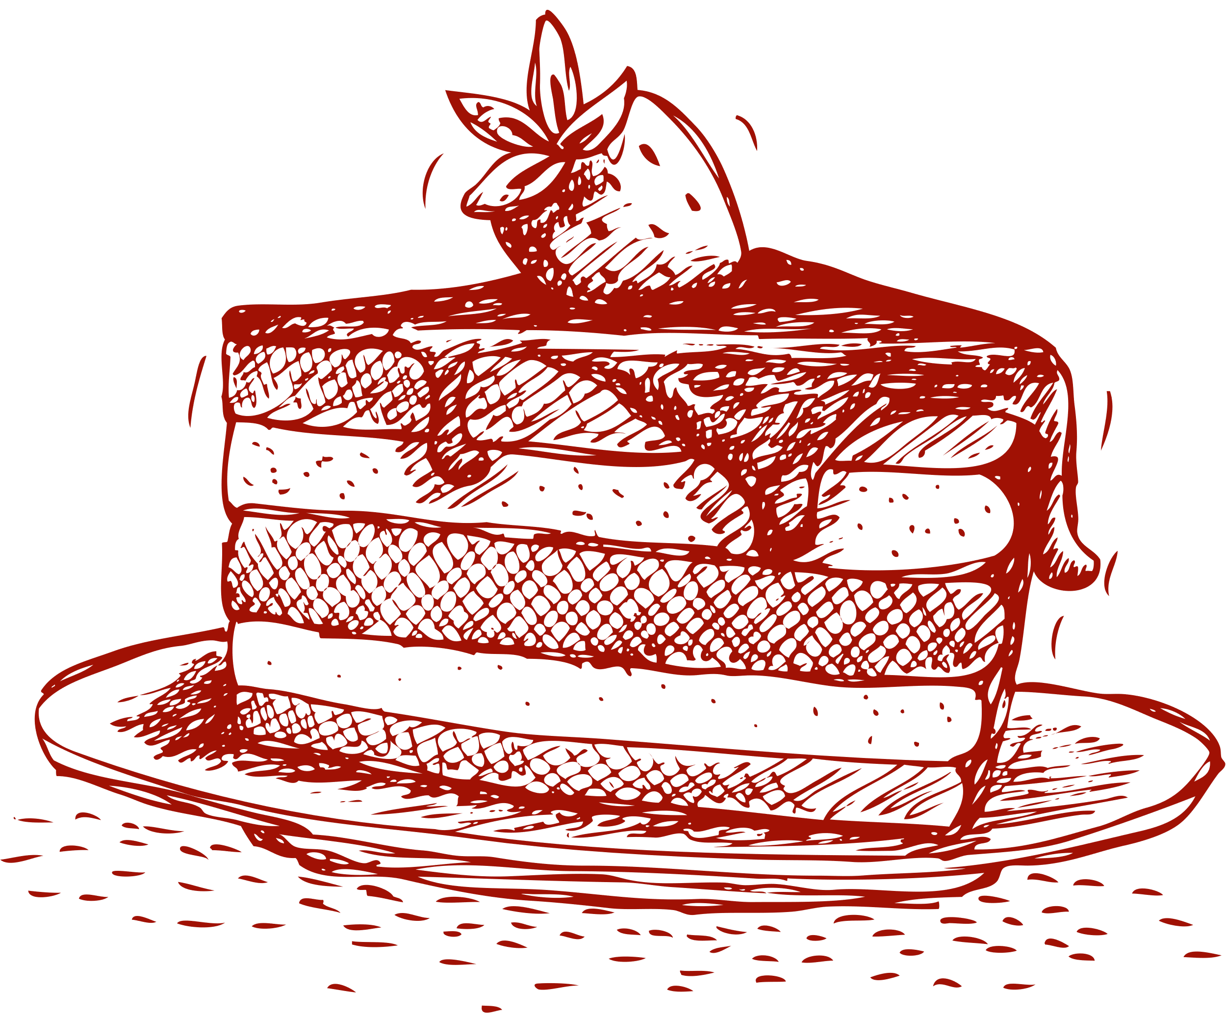
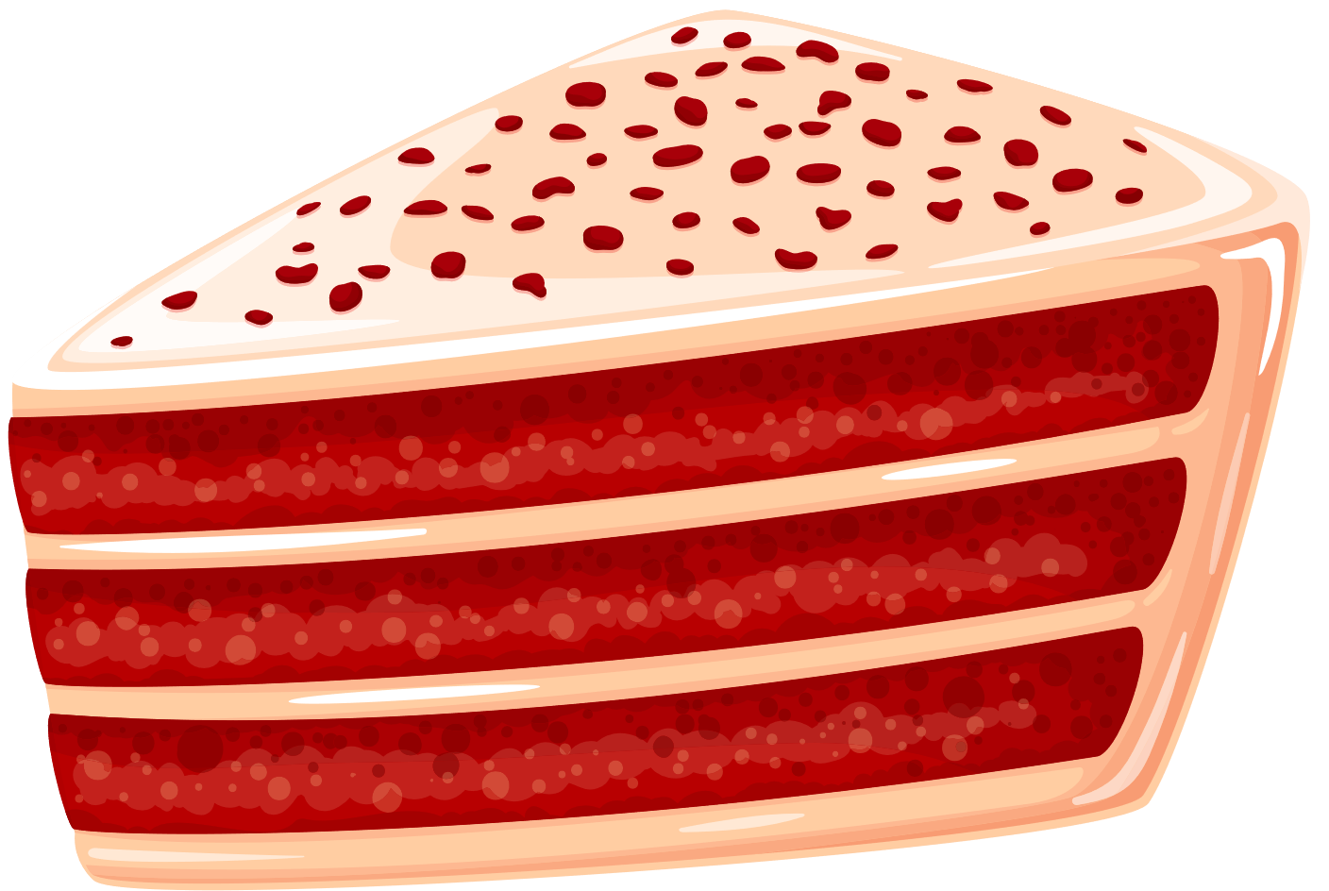
Red Velvet Cake
Ingredients
For the Cake:
2 1/2 cups all-purpose flour
2 tablespoons unsweetened cocoa powder
1 teaspoon baking soda
1/2 teaspoon salt
1 cup unsalted butter, softened
2 cups granulated sugar
4 large eggs
1 cup buttermilk
2 teaspoons vanilla extract
2 tablespoons red food coloring
For the Cream Cheese Frosting:
8 ounces cream cheese, softened
1/2 cup unsalted butter, softened
4 cups powdered sugar
1 teaspoon vanilla extract
Directions
Preheat oven to 350°F (175°C). Grease and flour two 9-inch round cake pans.
Whisk flour, cocoa powder, baking soda, and salt in a medium bowl.
Cream butter and sugar in a large mixing bowl until light and fluffy.
Add eggs one at a time, beating well after each addition. Mix in buttermilk, vanilla extract, and red food coloring.
Gradually add dry ingredients, mixing until just combined.
Divide batter between cake pans and smooth tops.
Bake for 25-30 minutes or until a toothpick inserted into the center comes out clean.
Cool cakes in pans for 10 minutes, then transfer to a wire rack to cool completely.
Prepare cream cheese frosting by beating cream cheese and butter until smooth. Gradually add powdered sugar and vanilla extract, beating until creamy.
Once cakes are cool, frost with cream cheese frosting.
Enjoy your homemade Red Velvet Cake!

