Slide 1
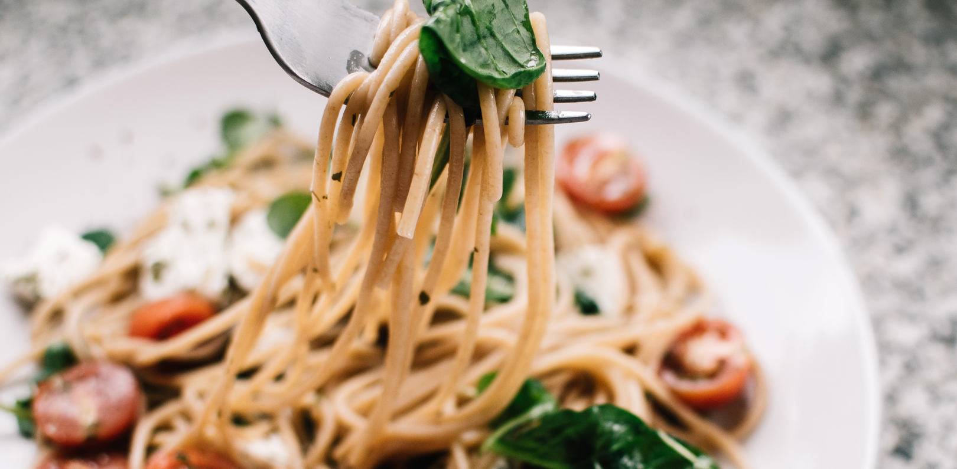
Tomato Basil Pastas
SERVINGS: 2
PREPPING TIME: 15 MIN
COOKING TIME: 30 MIN
Ingredients
Directions
200 grams spaghetti
2 tablespoons olive oil
2 cloves garlic, minced
1 can diced tomatoes
1/2 teaspoon salt
1/2 teaspoon pepper
1/2 cup fresh basil leaves, chopped
1/2 cup grated Parmesan cheese
Cook spaghetti according to package instructions. Drain, reserving 1 cup of the pasta water.
In a skillet, heat olive oil. Sauté garlic until fragrant, then add tomatoes, salt, and pepper. Cook until sauce thickens.
Add the cooked spaghetti to the skillet, tossing to combine, and adding reserved pasta water if needed.
Off the heat, garnish with basil and Parmesan. Serve immediately.
Tips:
Add a pinch of red pepper flakes for a kick.
You can substitute spaghetti with any pasta of your choice.

