Slide 1
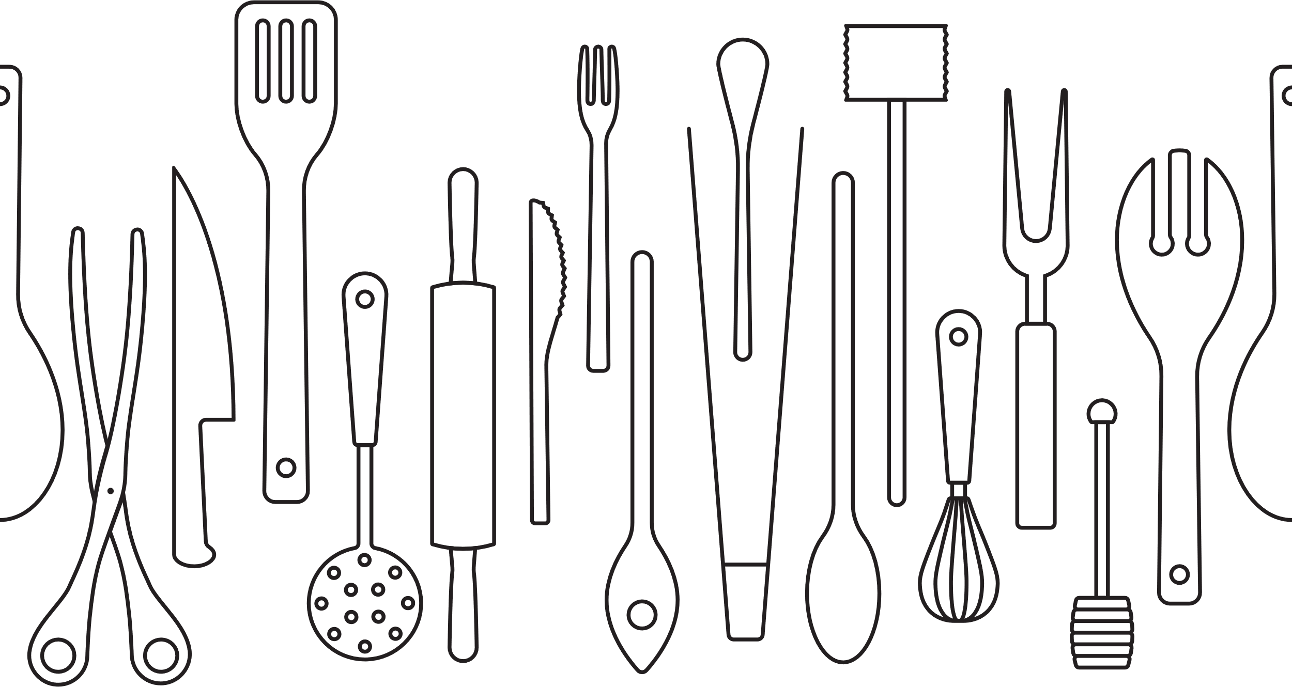
COOKBOOK
Serves
prep
cook
INGREDIENTS:
DIRECTIONS:
Notes

