Slide 1
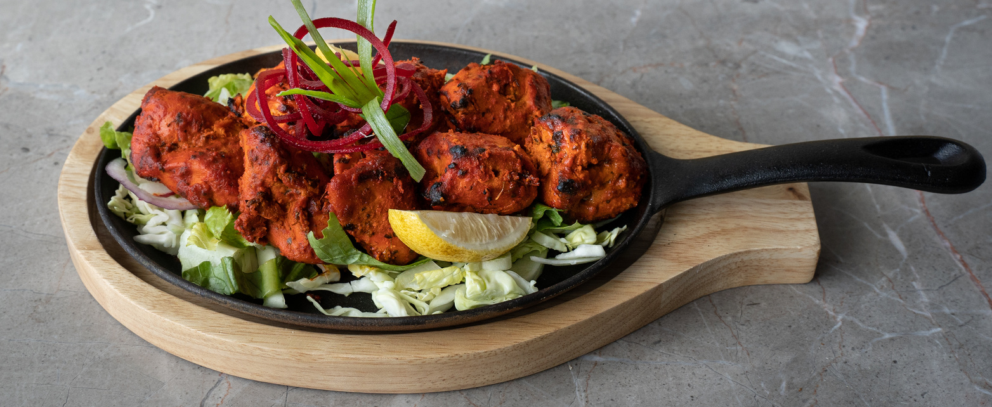
Chicken
Cordon Bleu
Serves: 4
Preparation Time: 20 Minutes
Cooking Time: 30 Minutes
INGREDIENTS
DIRECTIONS
4 boneless, skinless chicken breasts
4 slices of Swiss cheese
4 slices of ham
1/2 cup all-purpose flour
Salt and pepper to taste
2 large eggs
1 cup breadcrumbs
4 tbsp butter
1 cup chicken broth
1 tbsp cornstarch
1/2 cup heavy cream
Prepare the chicken: Preheat your oven to 350°F (175°C). Flatten the chicken breasts to about 1/4 inch thickness using a meat mallet. Place a slice of cheese and a slice of ham on each breast. Roll up tightly and secure with toothpicks.
Bread the chicken: Season the flour with salt and pepper in a shallow dish. Beat the eggs in another shallow dish. Place the breadcrumbs in a third shallow dish. Coat the chicken rolls in the flour, dip in the beaten eggs, then roll in the breadcrumbs.
Cook the chicken: Melt the butter in a large oven-safe skillet over medium heat. Add the chicken rolls and cook until golden brown on all sides, about 5 minutes. Transfer the skillet to the preheated oven and bake for 20 minutes, or until the chicken is cooked through.
Make the sauce: While the chicken is baking, prepare the sauce. Combine the chicken broth and cornstarch in a small saucepan, stirring until smooth. Bring to a simmer over medium heat. Stir in the heavy cream and cook until the sauce thickens, about 2-3 minutes.
Serve: Remove the chicken from the oven and let it rest for a few minutes. Remove the toothpicks, slice the chicken, and serve with the sauce.

