Slide 1
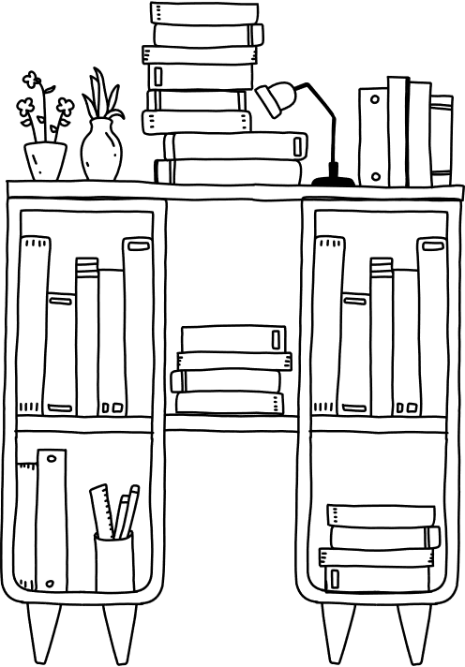
bookshelf reading log

