Slide 1
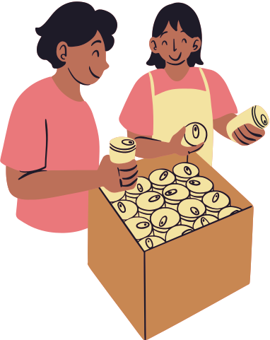
FUNDRAISING RAFFLE TICKET
A FUNDRAISING EVENT FOR CHILDREN'S CHARITIES
10AM 15 JUNE 2028 ANY CAFÉ
FUNDRAISING RAFFLE TICKET
10AM 15 JUNE 2028 | ANY CAFÉ

Slide 2
TERMS AND CONDITIONS
A FUNDRAISING EVENT FOR CHILDREN'S CHARITIES
All proceeds from the event will be donated to children's charities. This ticket cannot be refunded nor transferred to another person.
FUNDRAISING RAFFLE TICKET

