Slide 1
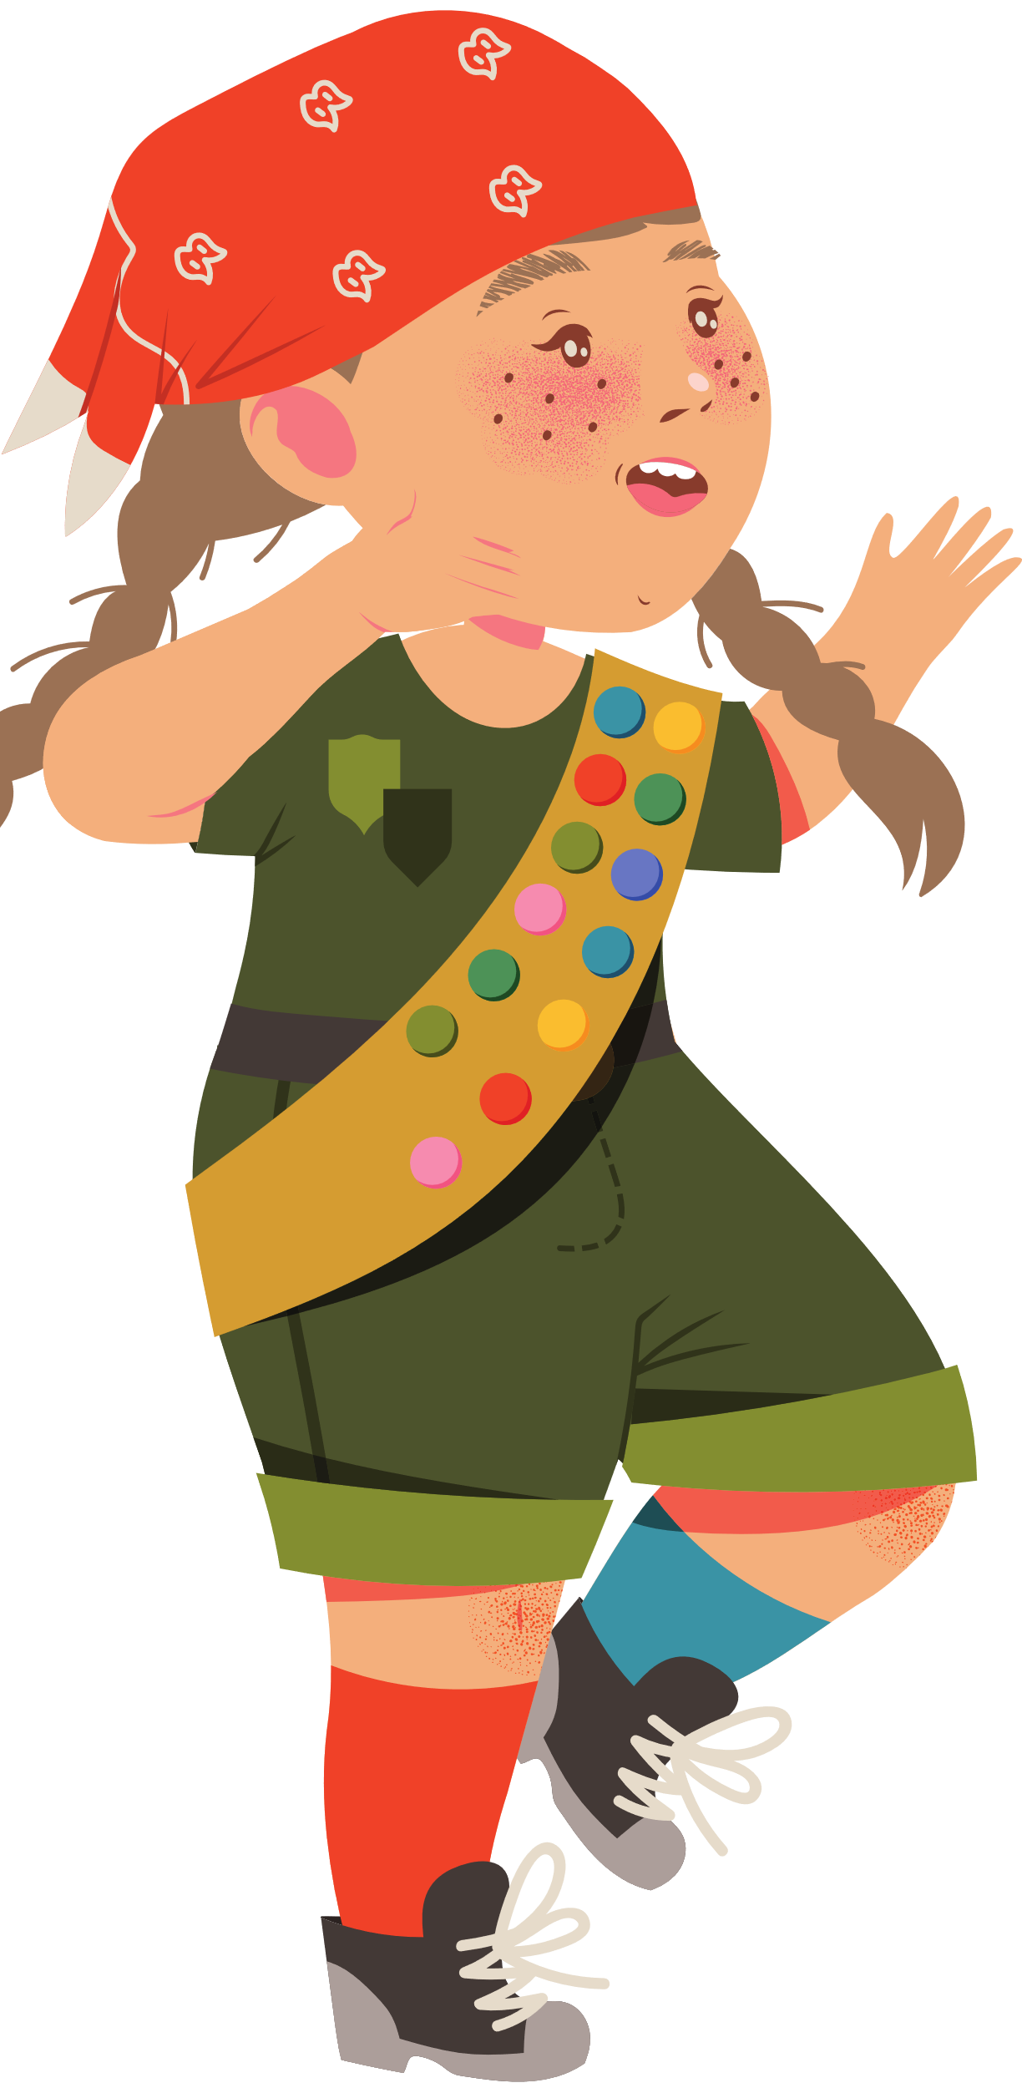
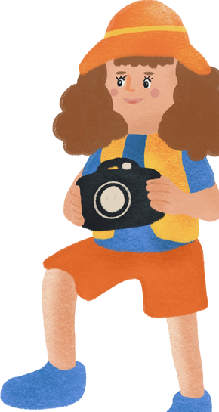
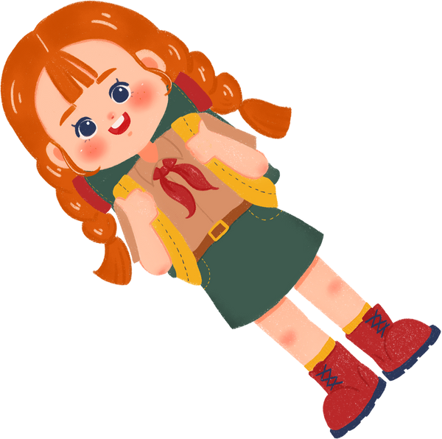
I will do my best to be
I will do my best to be
I will do my best to be
I will do my best to be
honest and fair,
friendly and helpful, considerate and caring, courageous and strong, and responsible for
what I say and do.
honest and fair,
friendly and helpful, considerate and caring, courageous and strong, and responsible for
what I say and do.
honest and fair,
friendly and helpful, considerate and caring, courageous and strong, and responsible for
what I say and do.
honest and fair,
friendly and helpful, considerate and caring, courageous and strong, and responsible for
what I say and do.
GIRL SCOUT BOOKMARK

