Slide 1
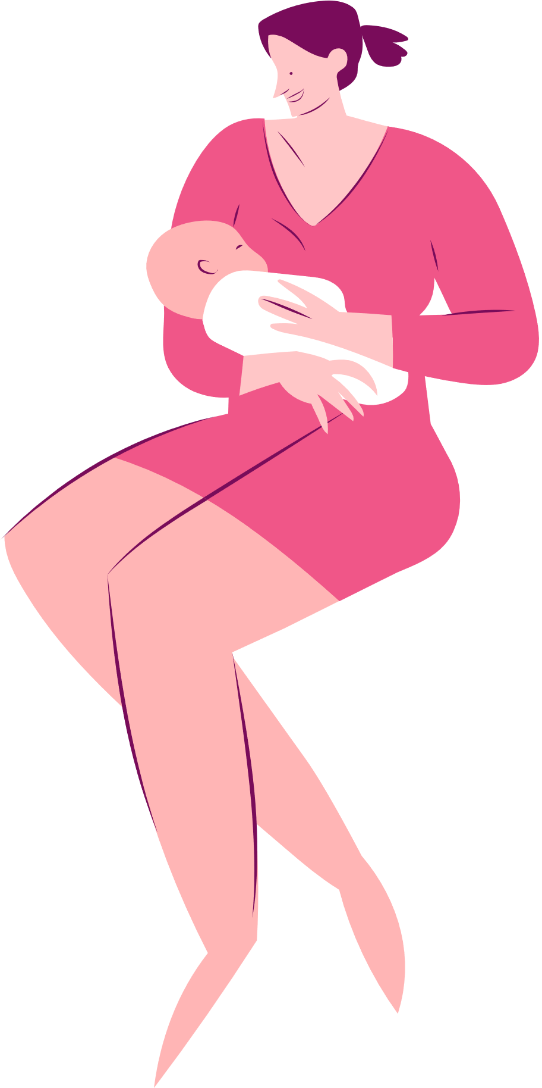
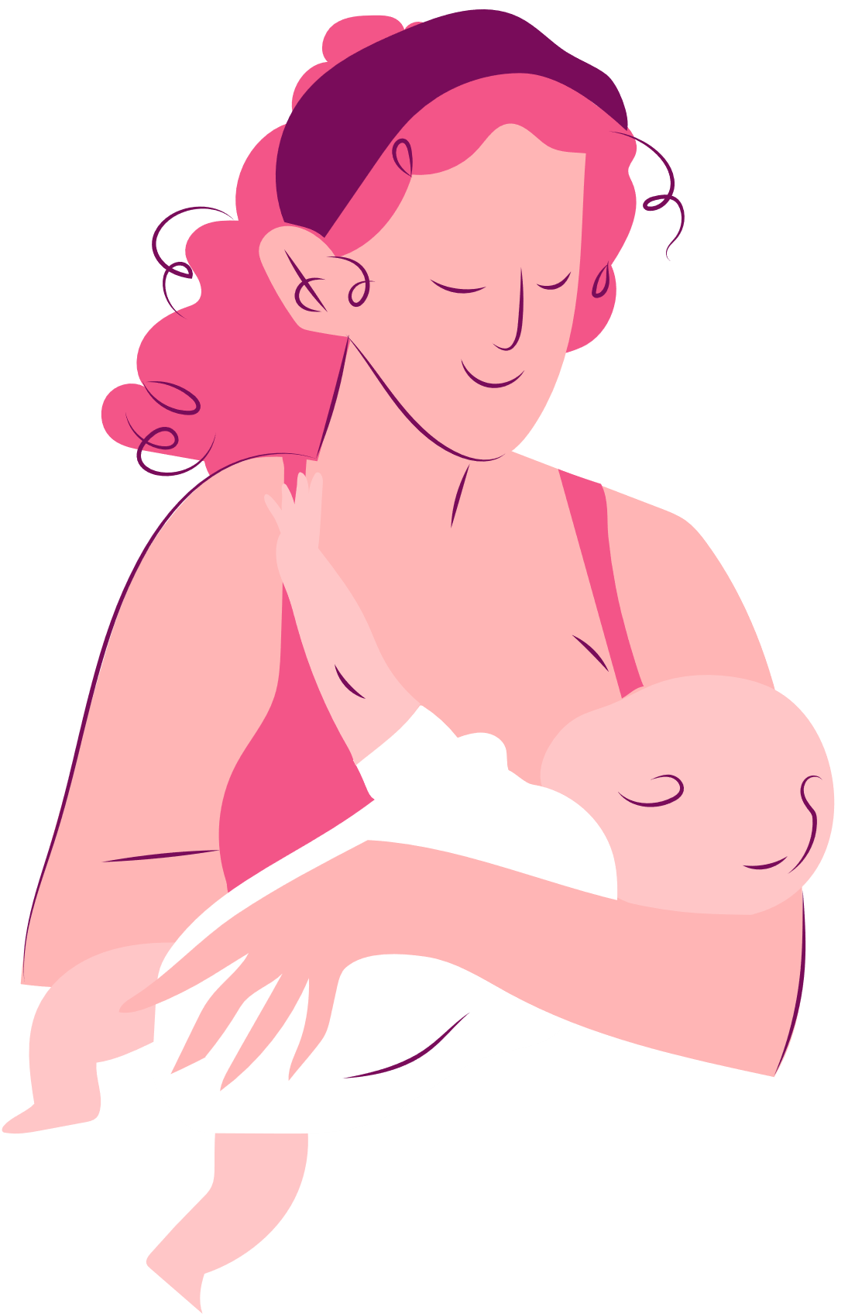
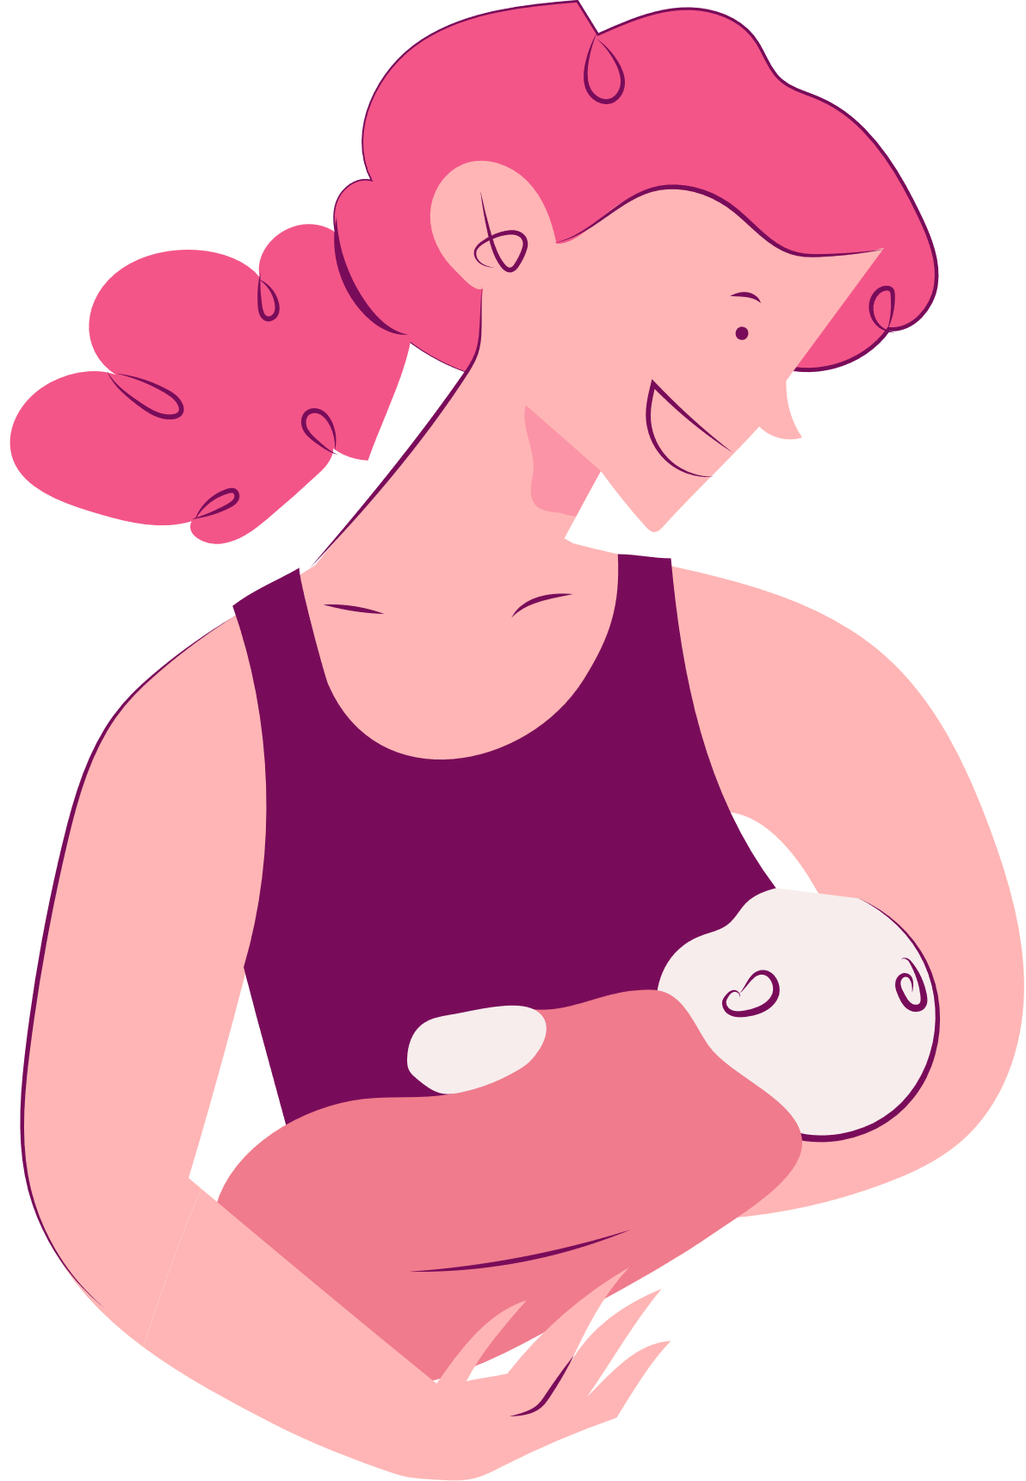
You're
the best,
Mom!
Happy
I love you,
Mom!
Thank you
for everything,
Mom!
mother's day!
MOTHER'S DAY BOOKMARK

